Slide 1
Progress Update
January 16, 2021
David Chen

Slide 2
Regression Analysis and
K-means Clustering

Slide 3
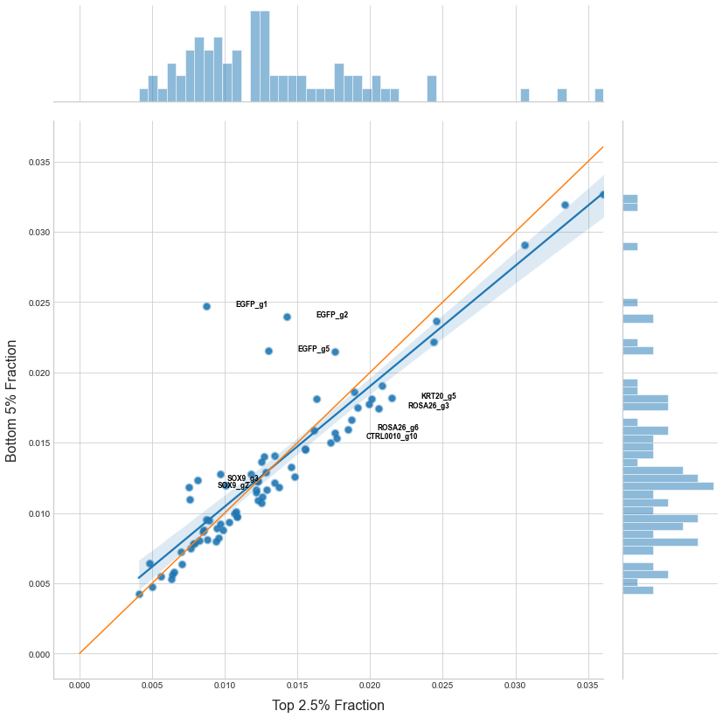
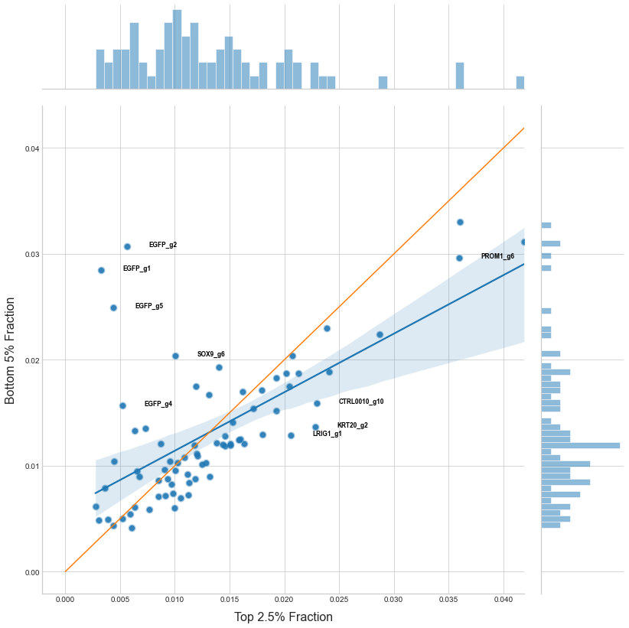
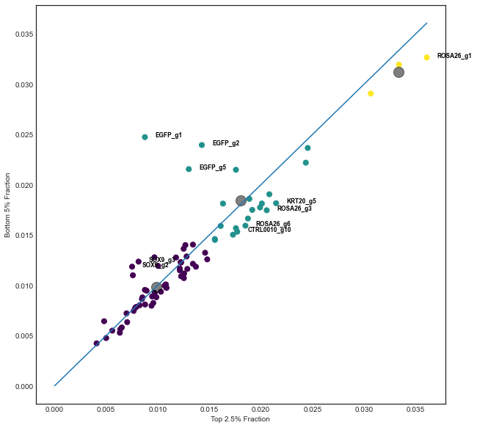
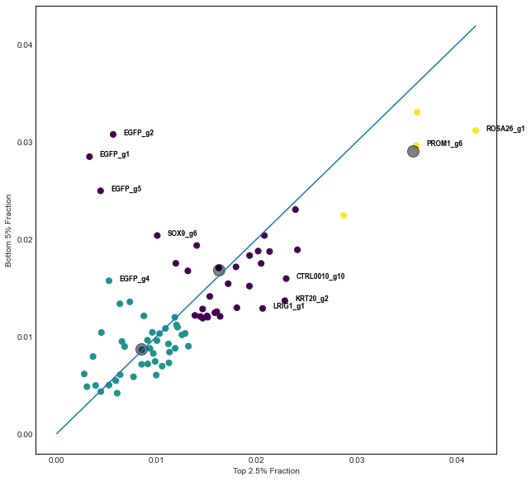
Primer 3
Top 2.5% vs Bottom 5%
Day 3
Day 7

Slide 4
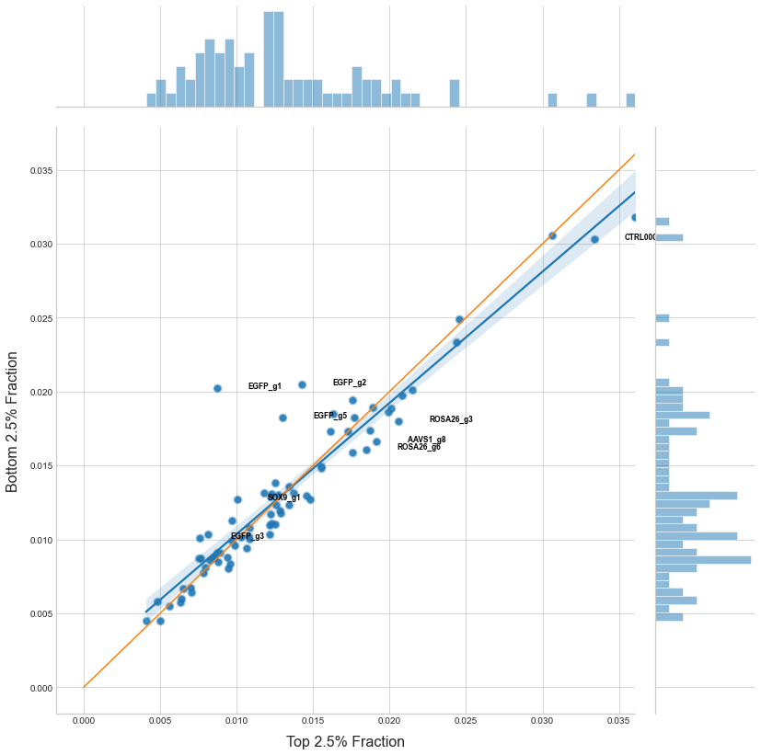
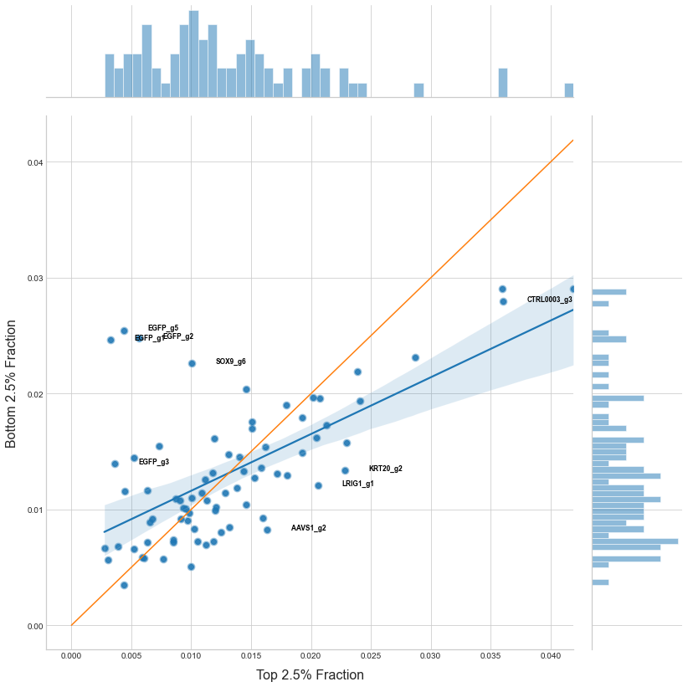
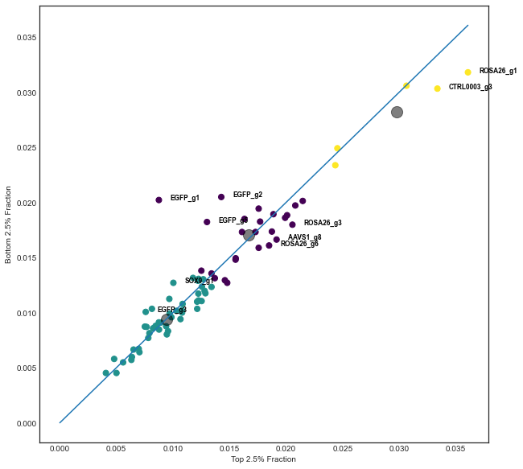
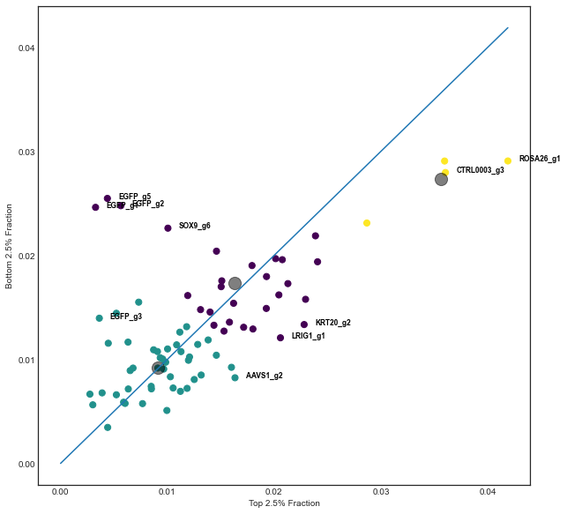
Primer 3
Top 2.5% vs Bottom 2.5%
Day 3
Day 7

Slide 5
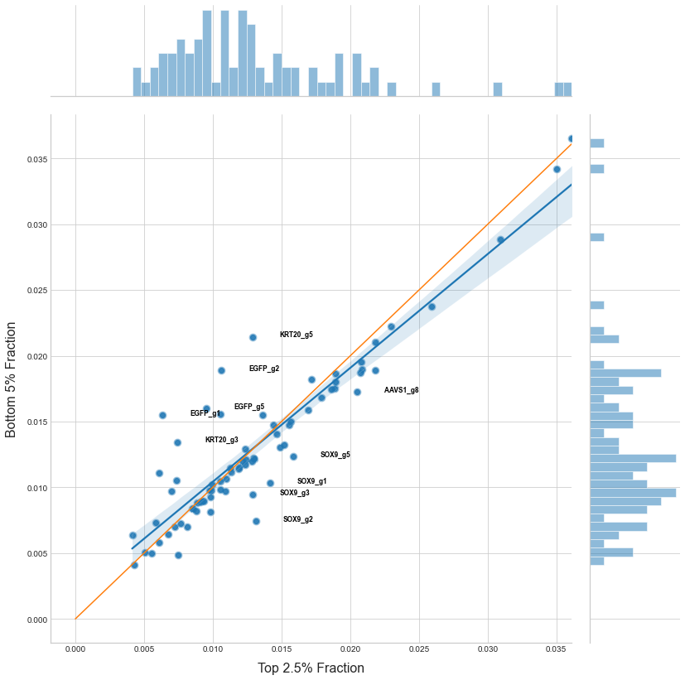
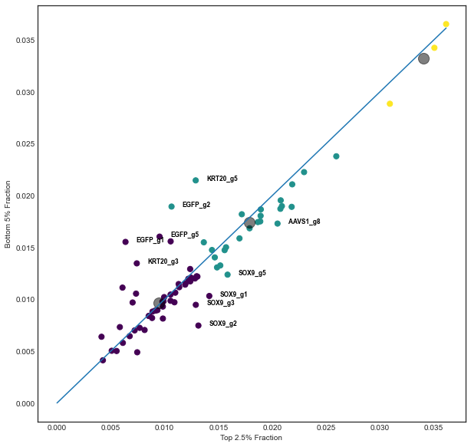
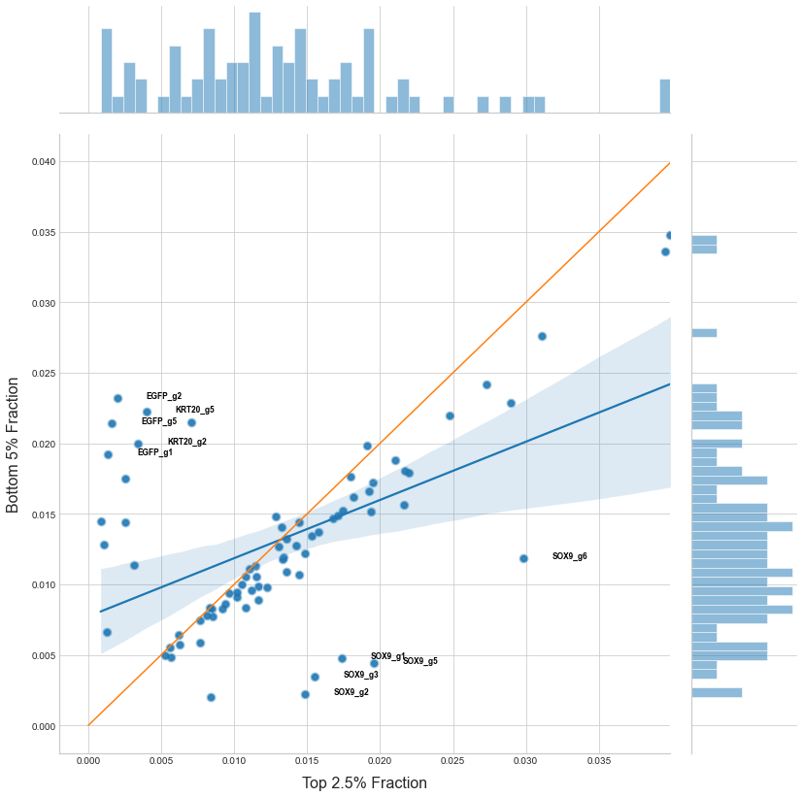
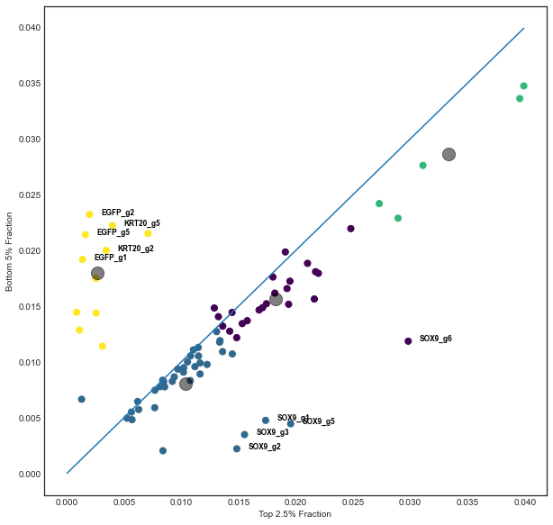
Primer 4
Top 2.5% vs Bottom 5%
Day 3
Day 7

Slide 6
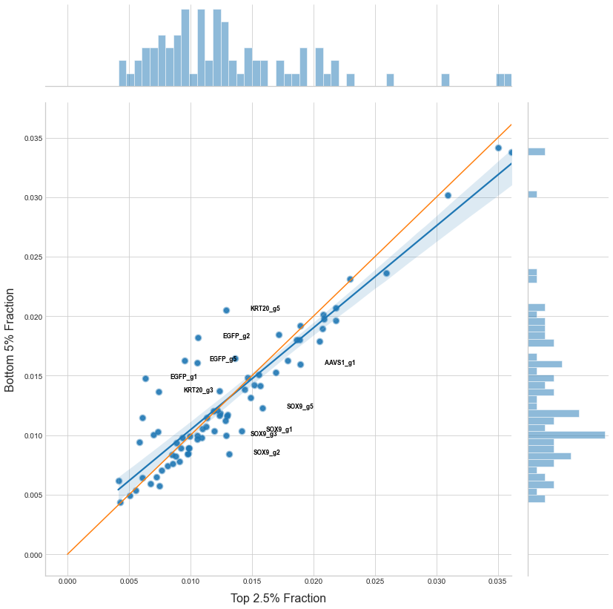
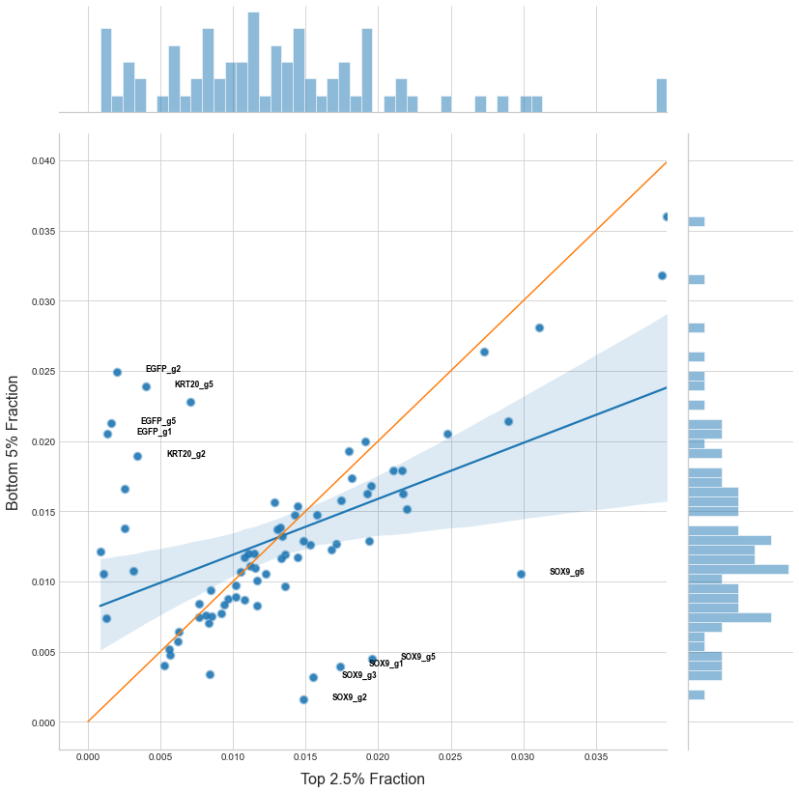
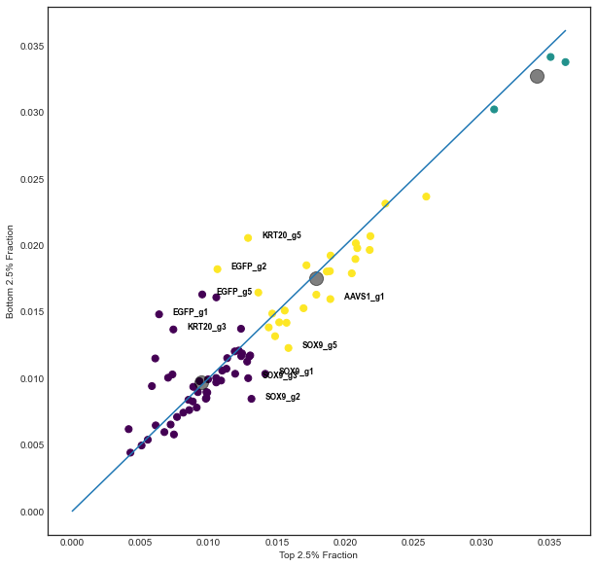
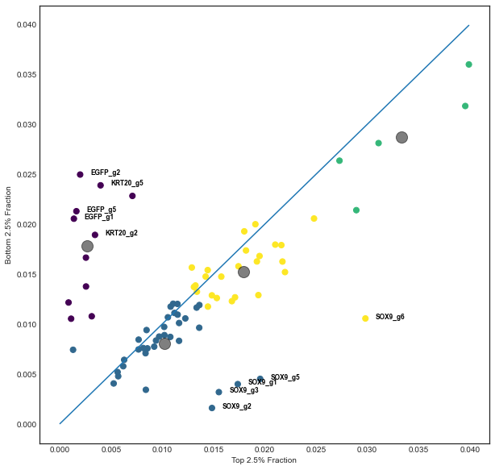
Primer 4
Top 2.5% vs Bottom 2.5%
Day 3
Day 7

Slide 7
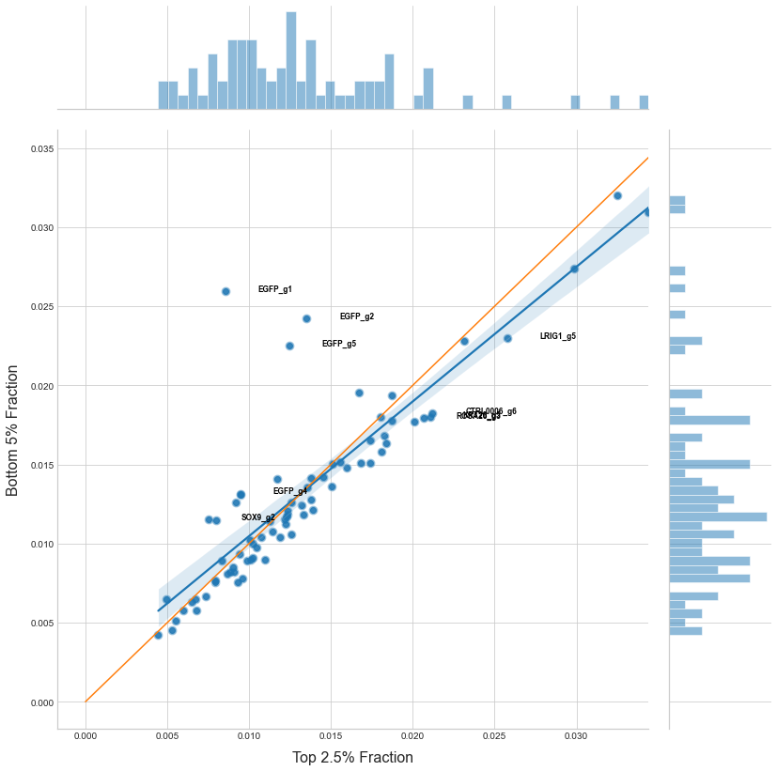
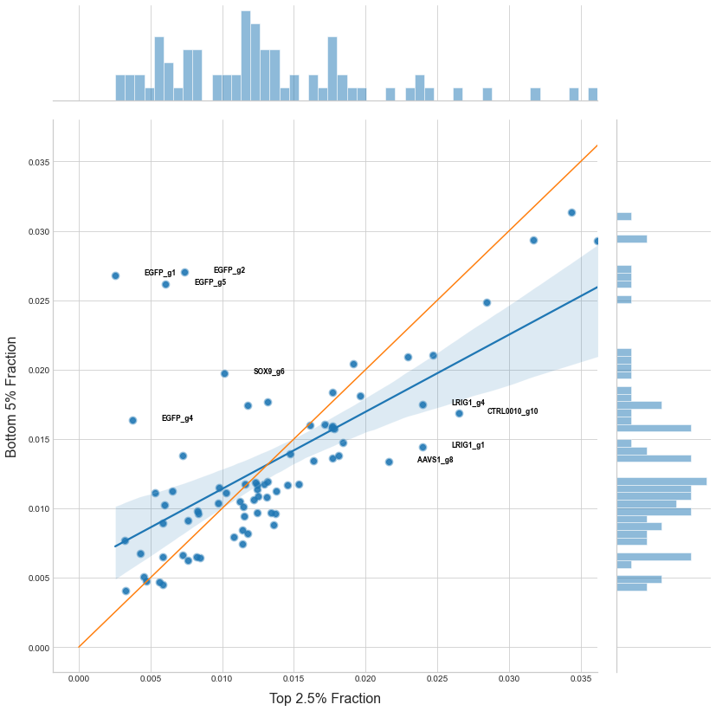
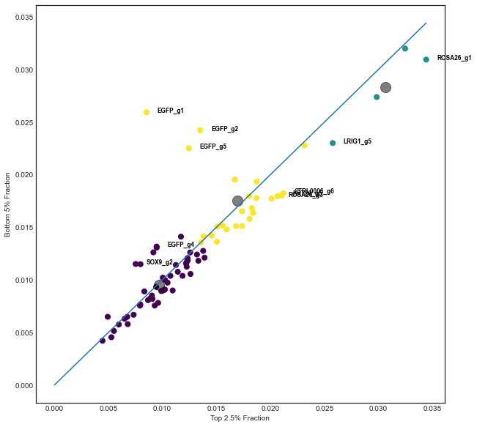
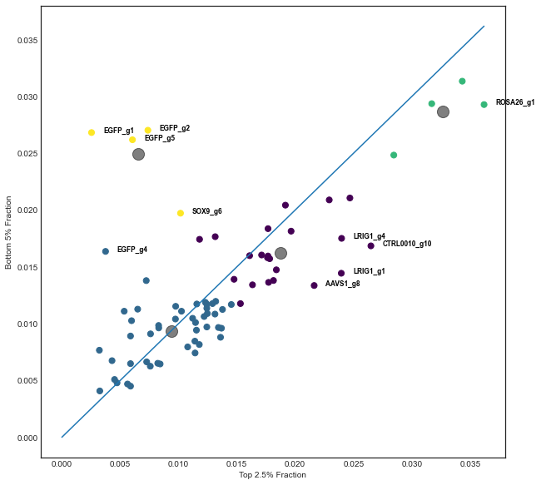
Primer 5
Top 2.5% vs Bottom 5%
Day 3
Day 7

Slide 8
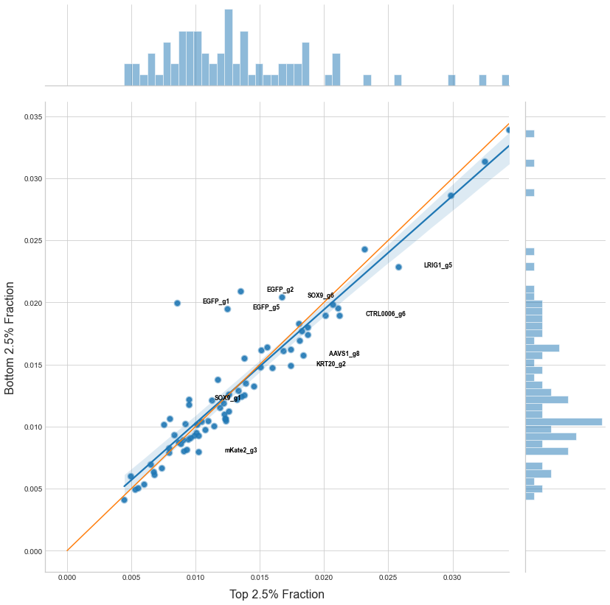
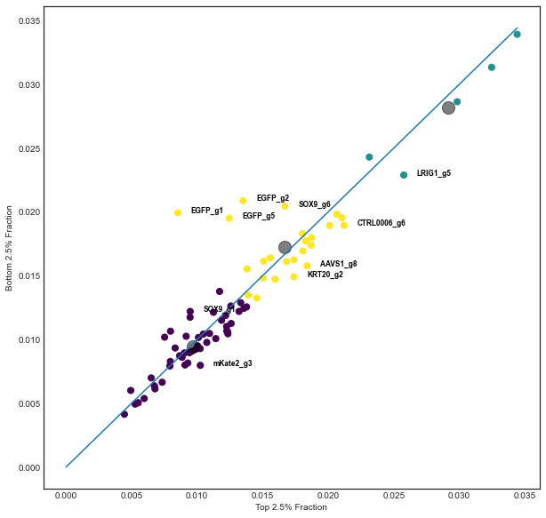
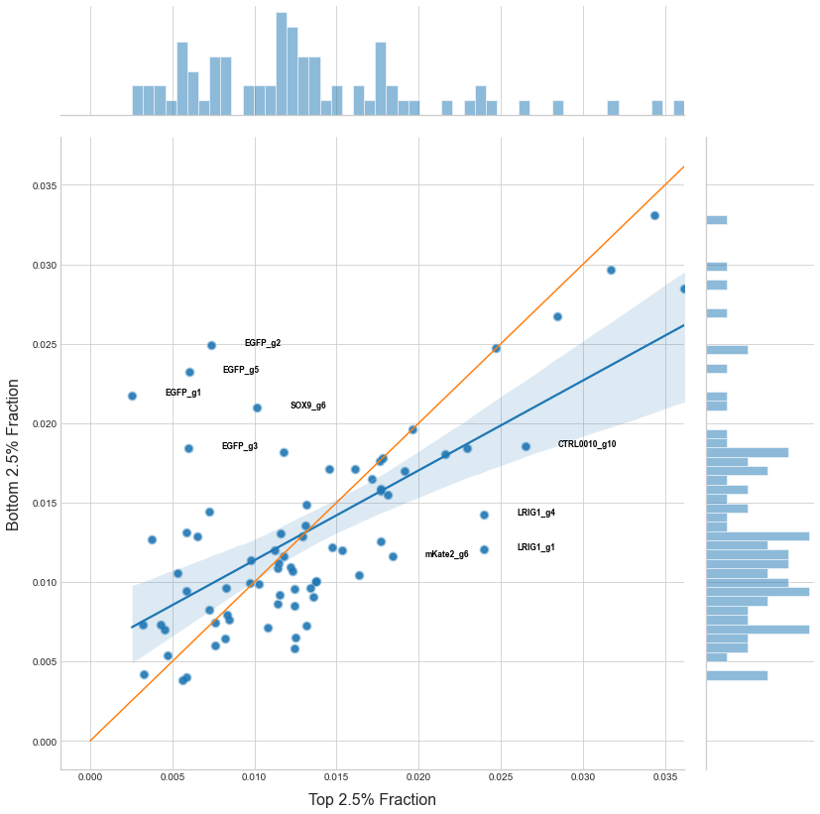
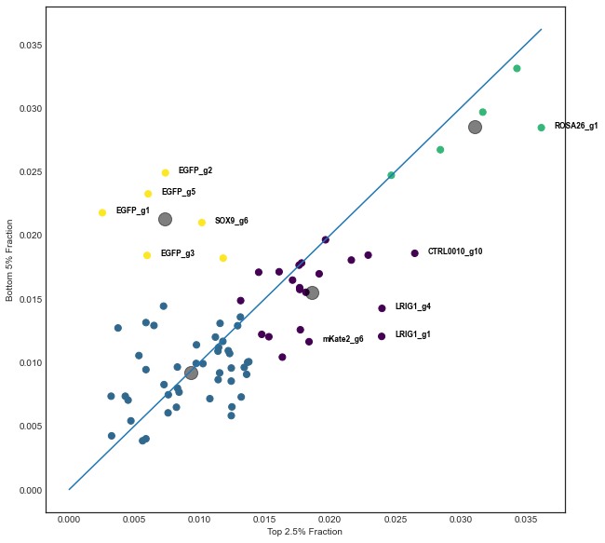
Primer 5
Top 2.5% vs Bottom 2.5%
Day 3
Day 7

Slide 9
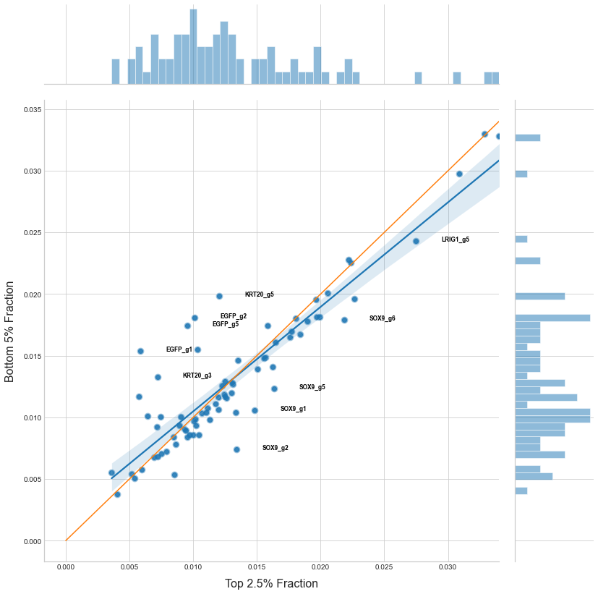
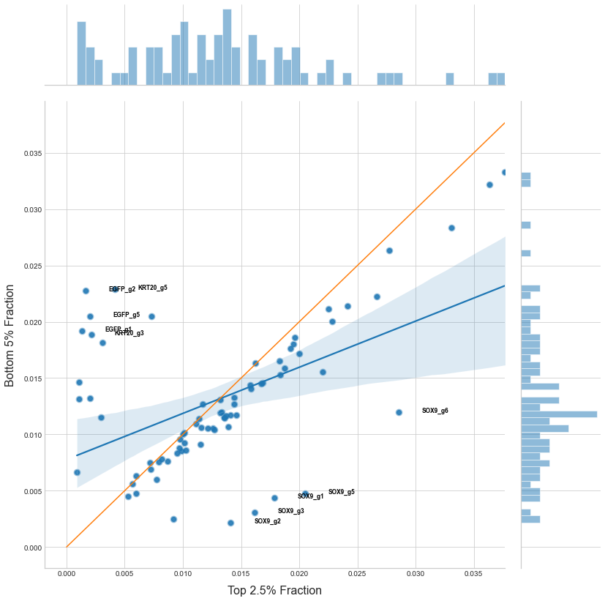
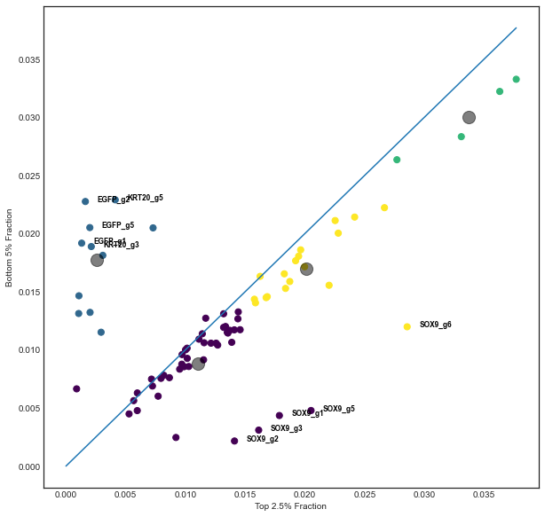
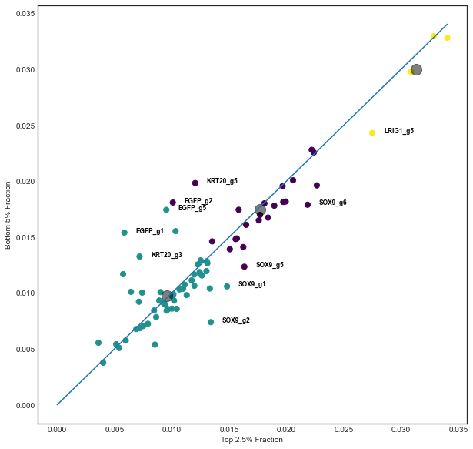
Primer 6
Top 2.5% vs Bottom 5%
Day 3
Day 7

Slide 10
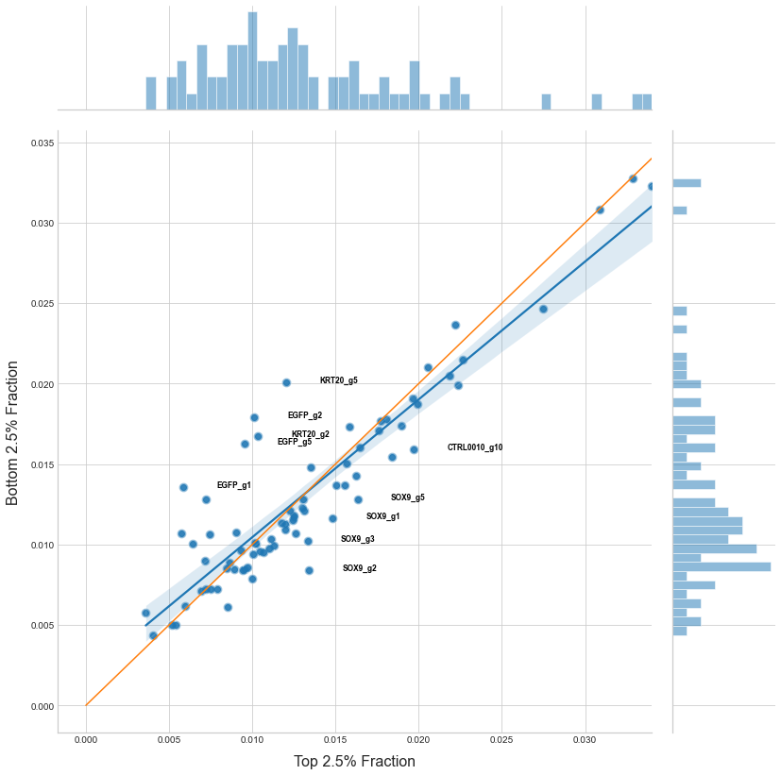
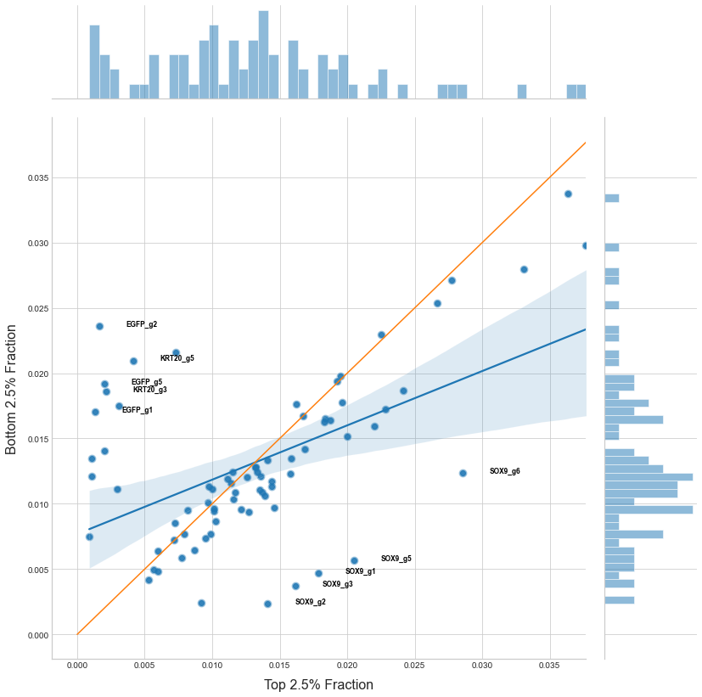
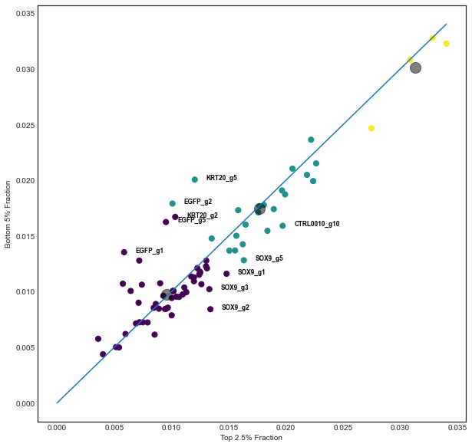
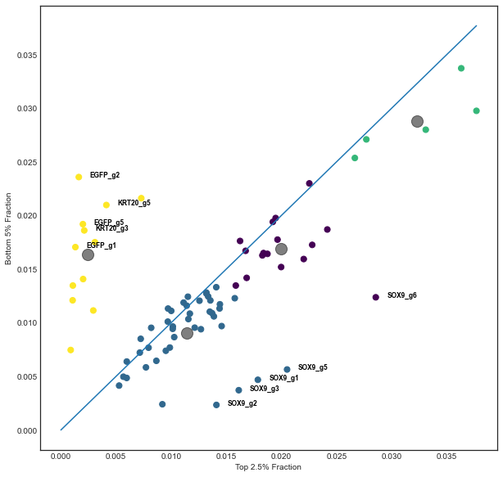
Primer 6
Top 2.5% vs Bottom 2.5%
Day 3
Day 7

Slide 11
MaGeCK Gene
Positive and Negative
Selection P-value

Slide 12
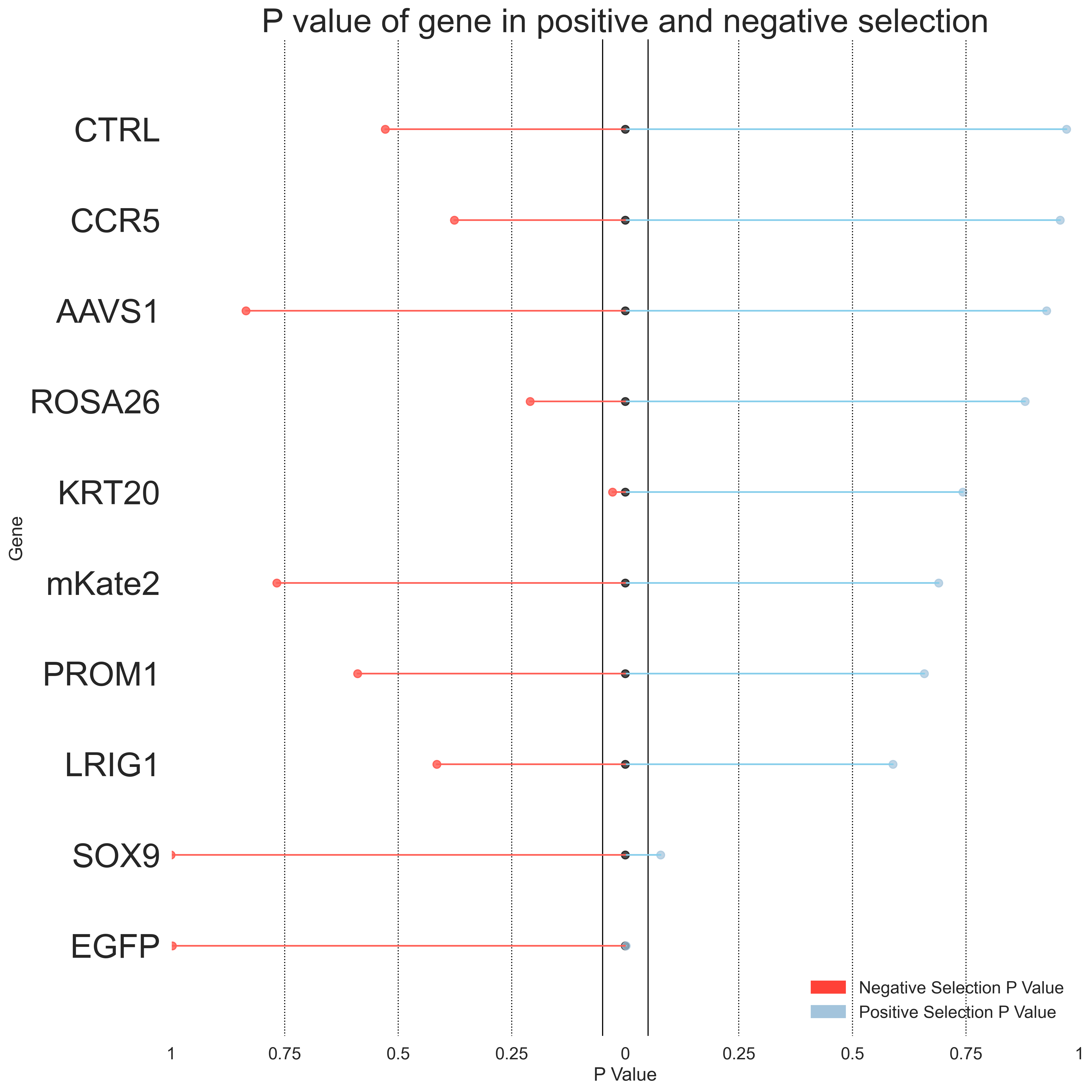
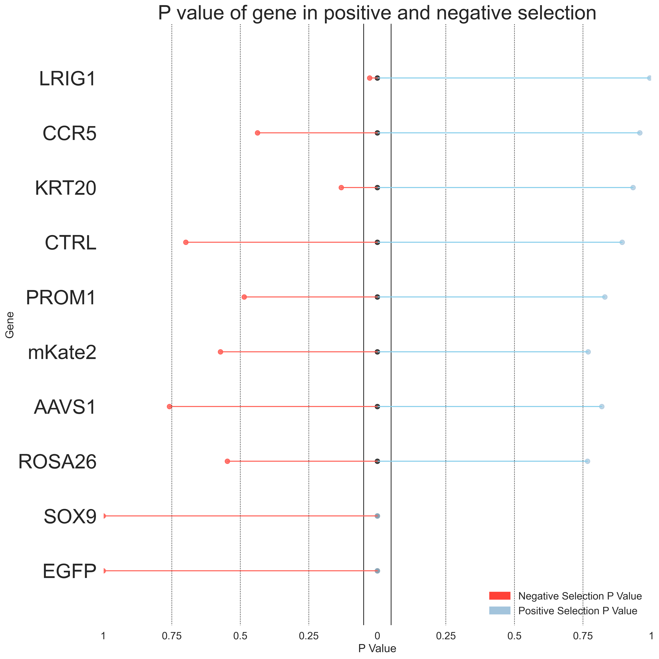
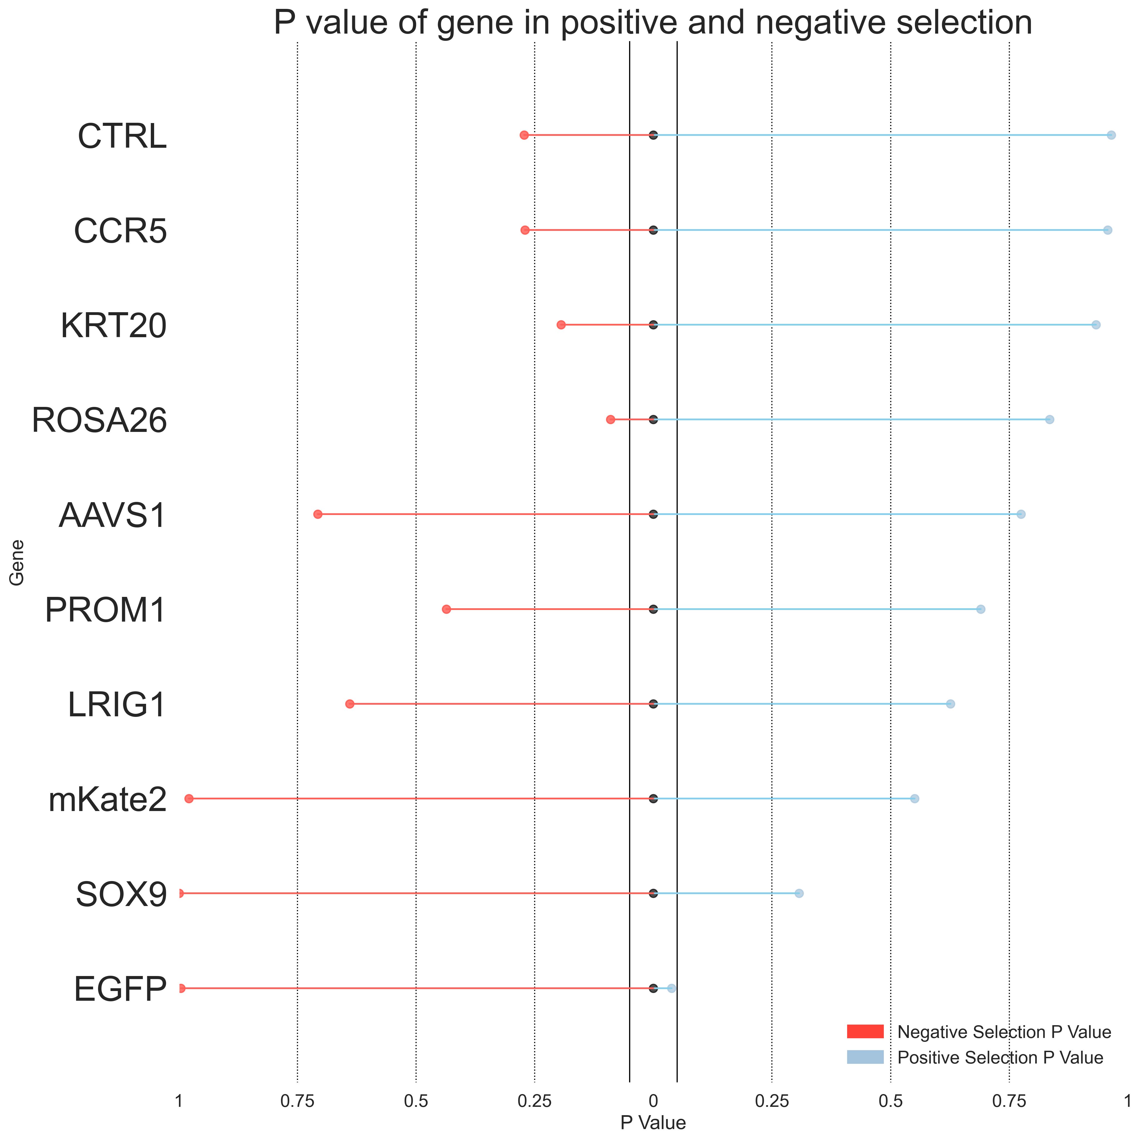
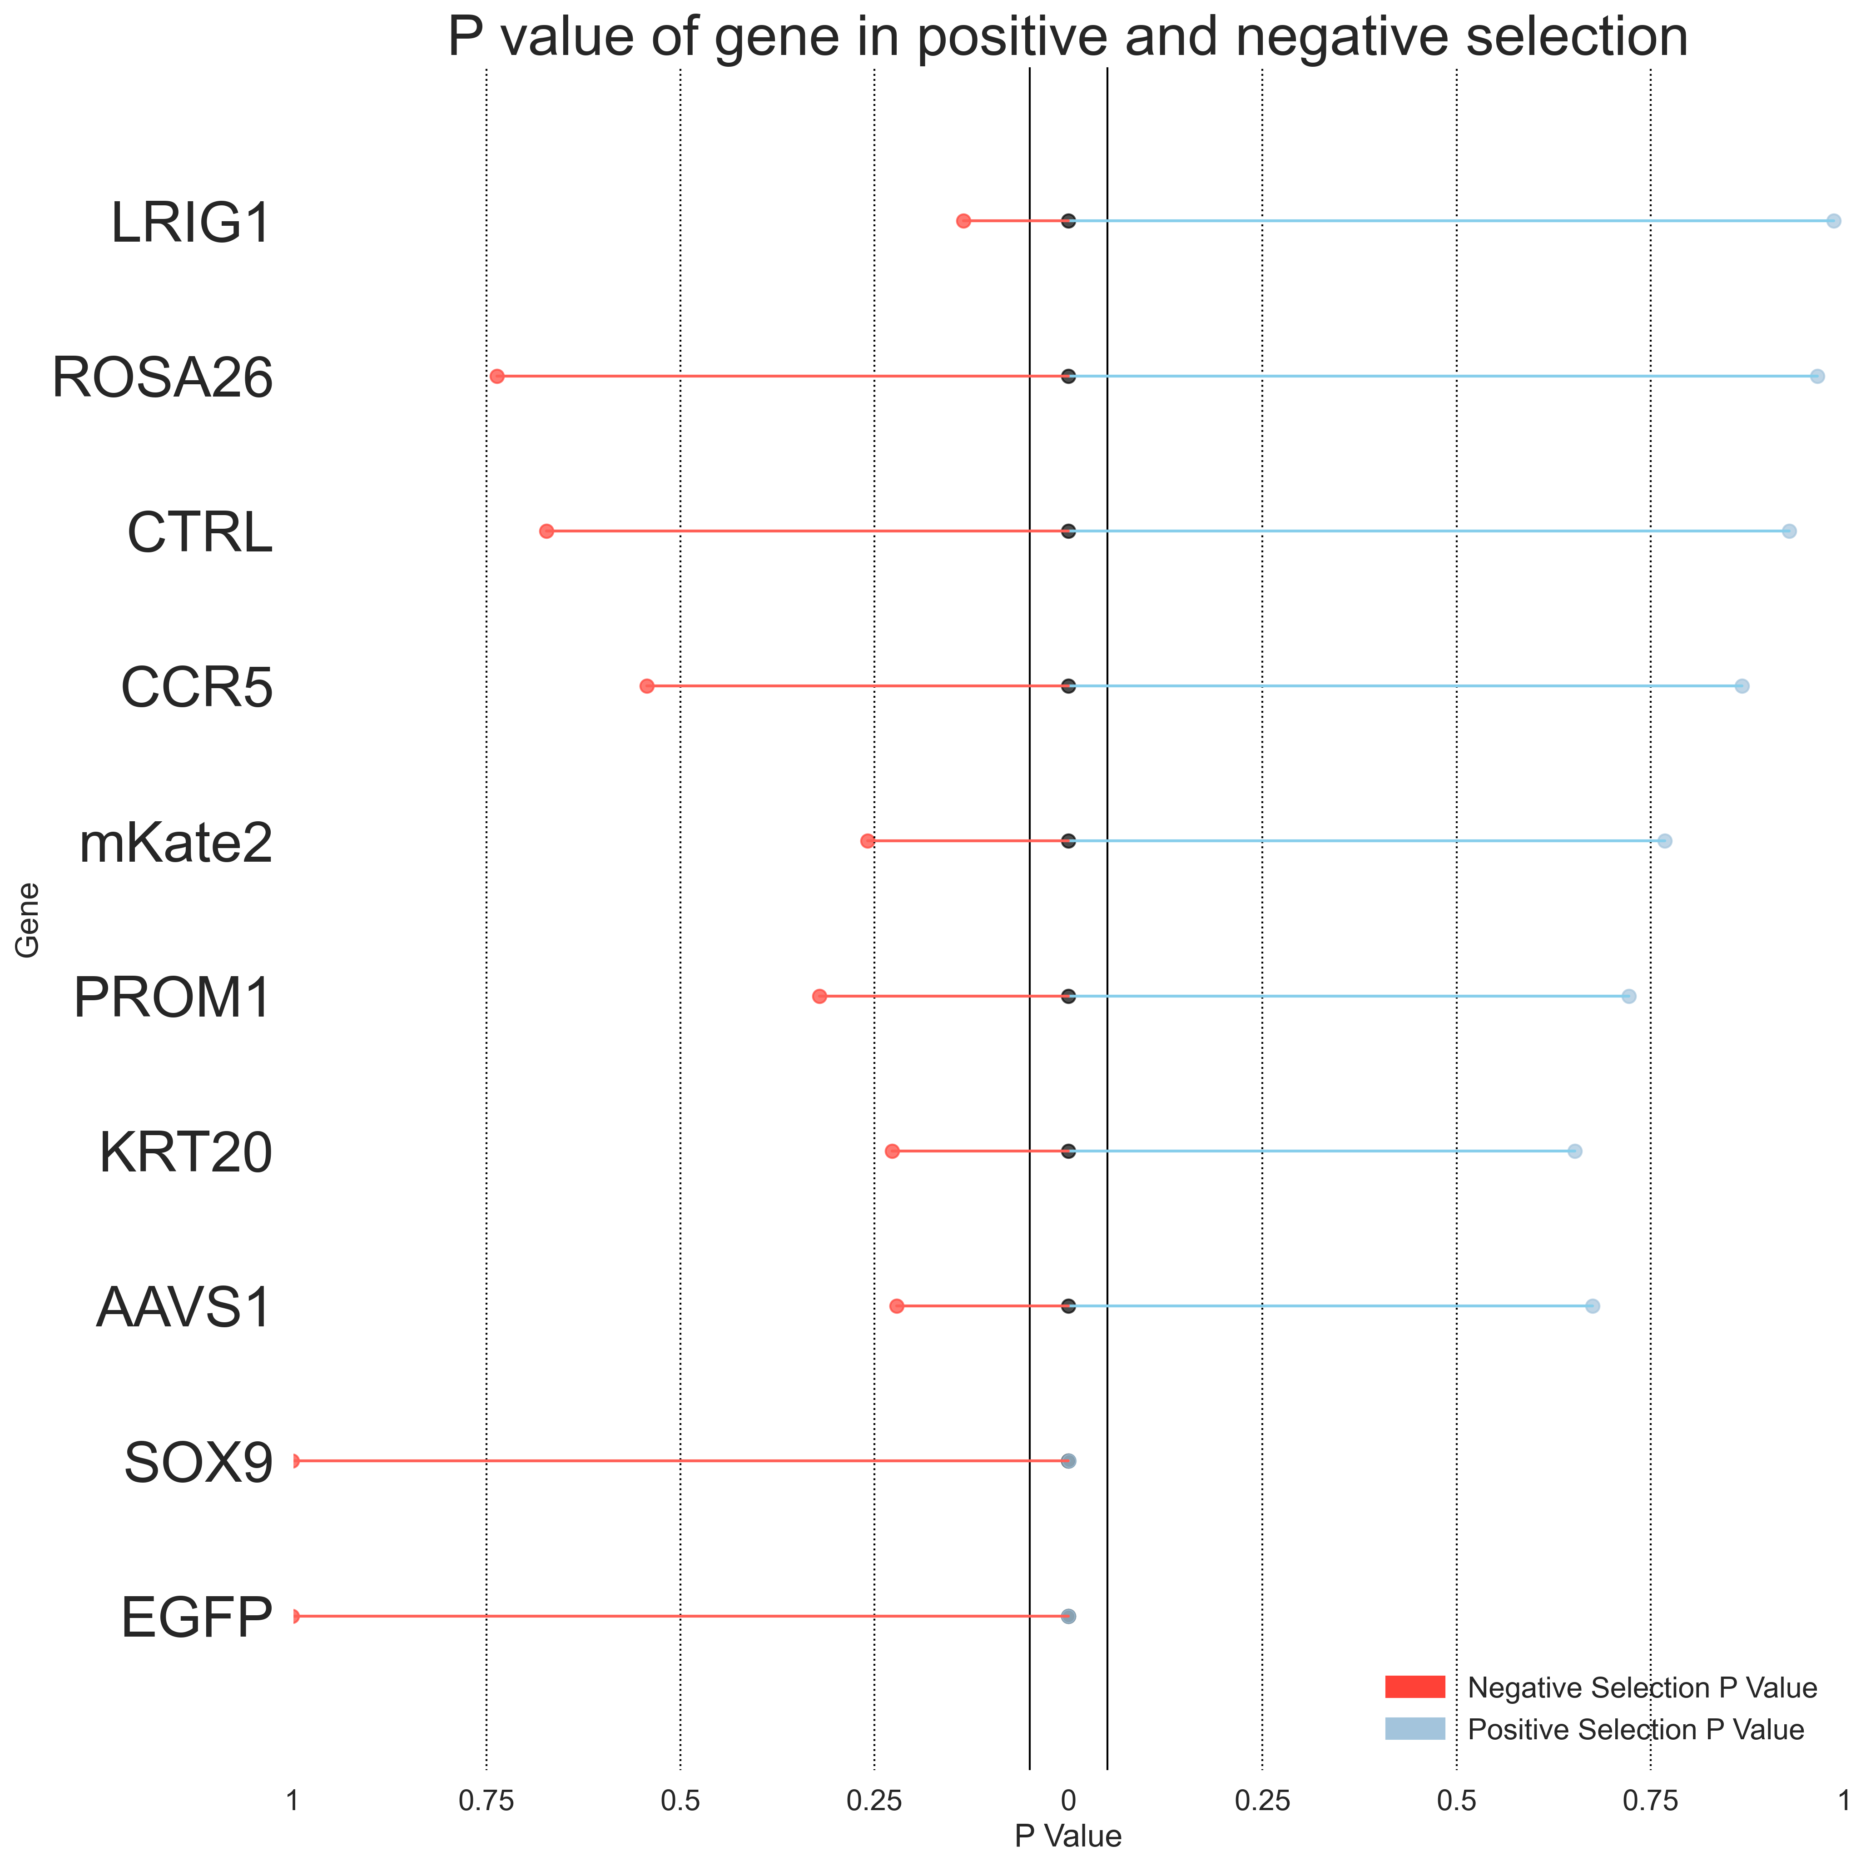
Primer 3
Top 2.5% vs Bottom 5%
Top 2.5% vs Bottom 2.5%
Day 3
Day 7
Day 3
Day 7
* Indicates P value < 0.05
*EGFP
*SOX9
*EGFP
*SOX9
*KRT20
*LRIG1
*EGFP
*EGFP

Slide 13
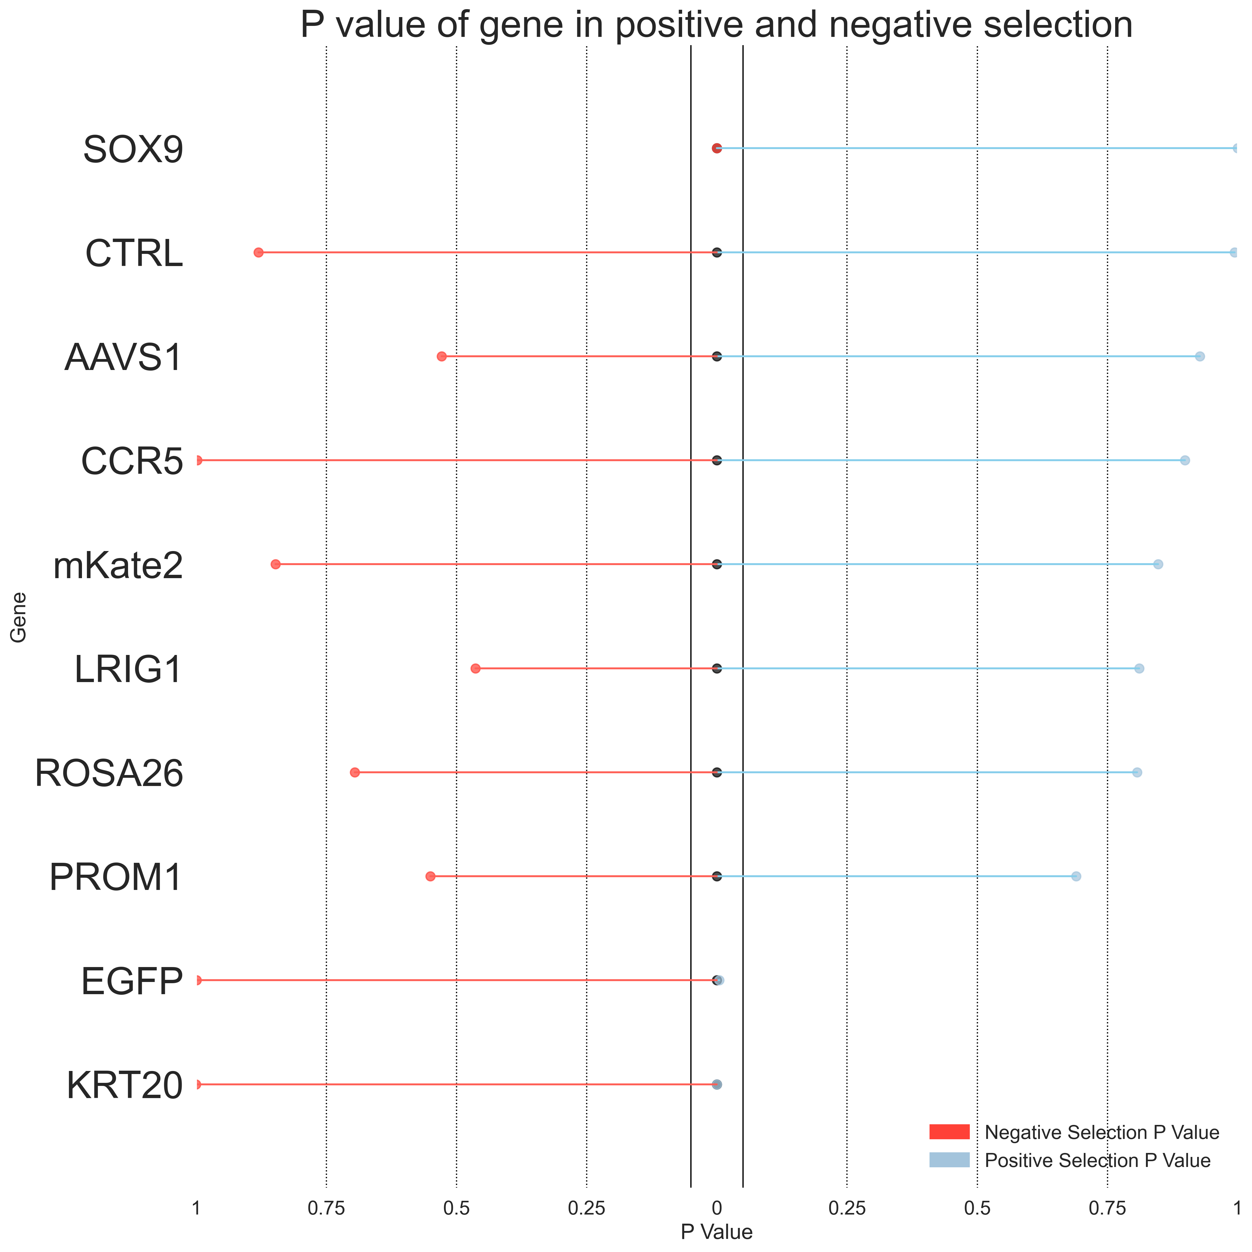
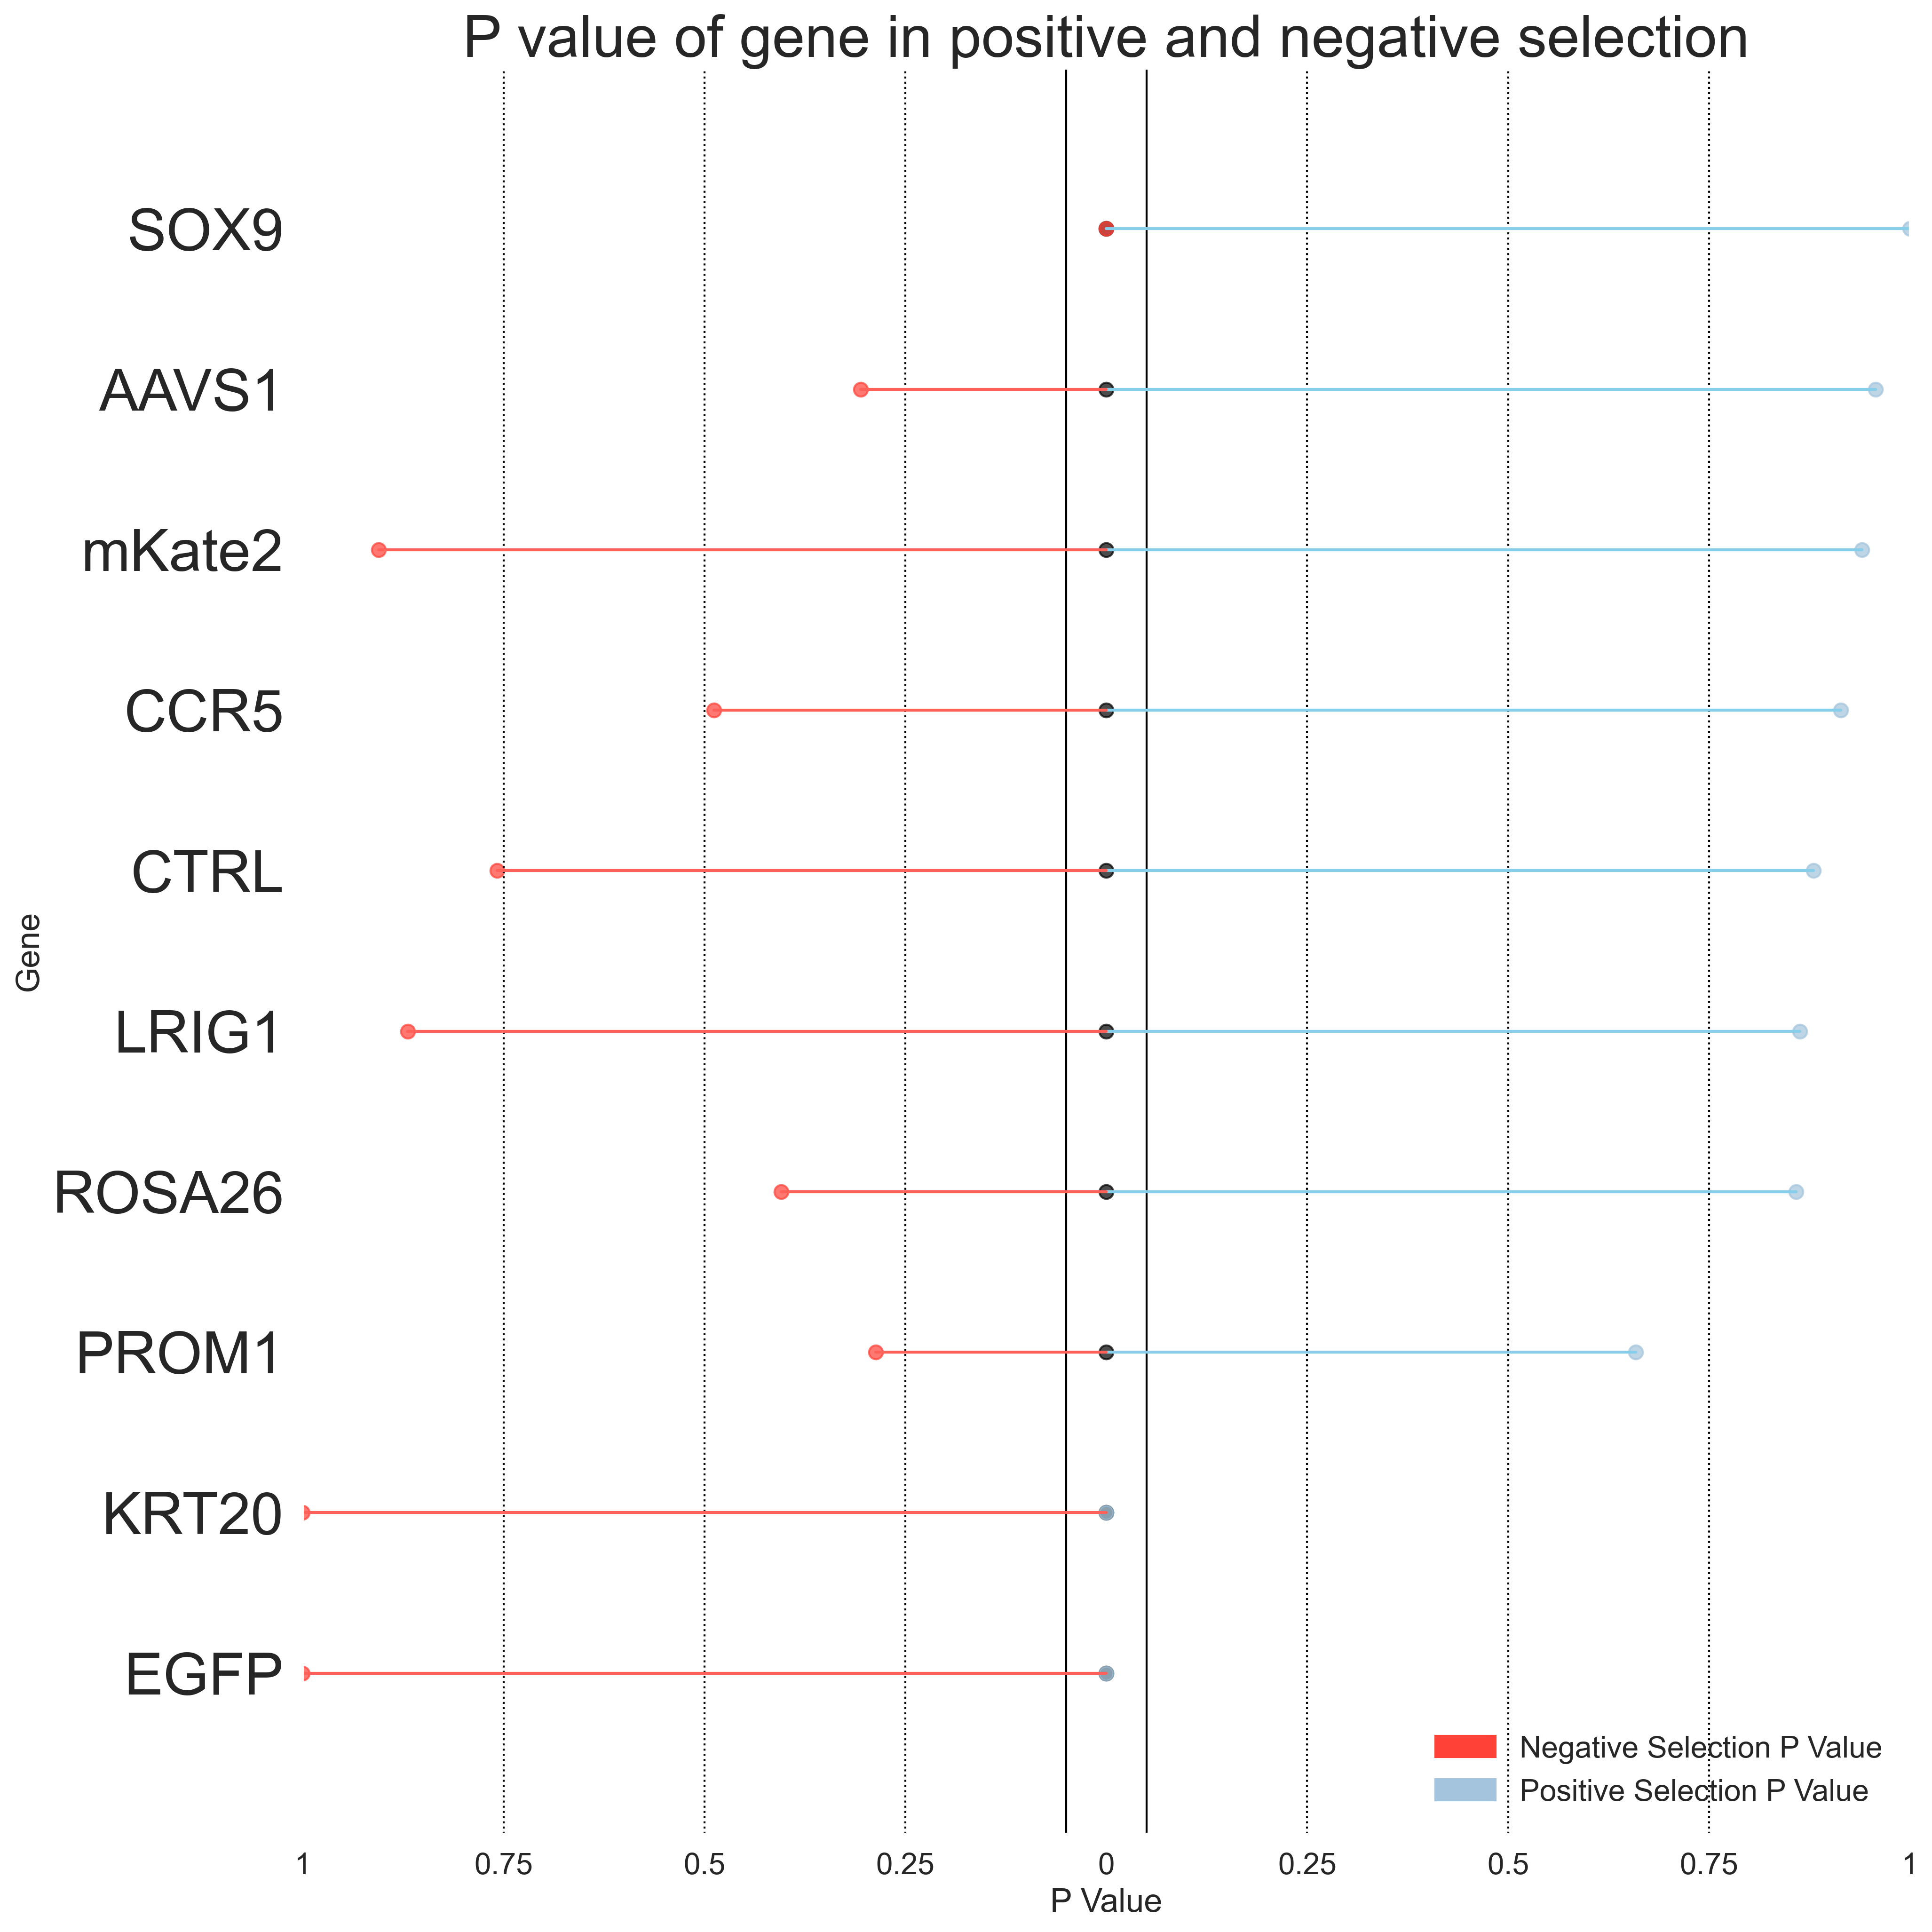
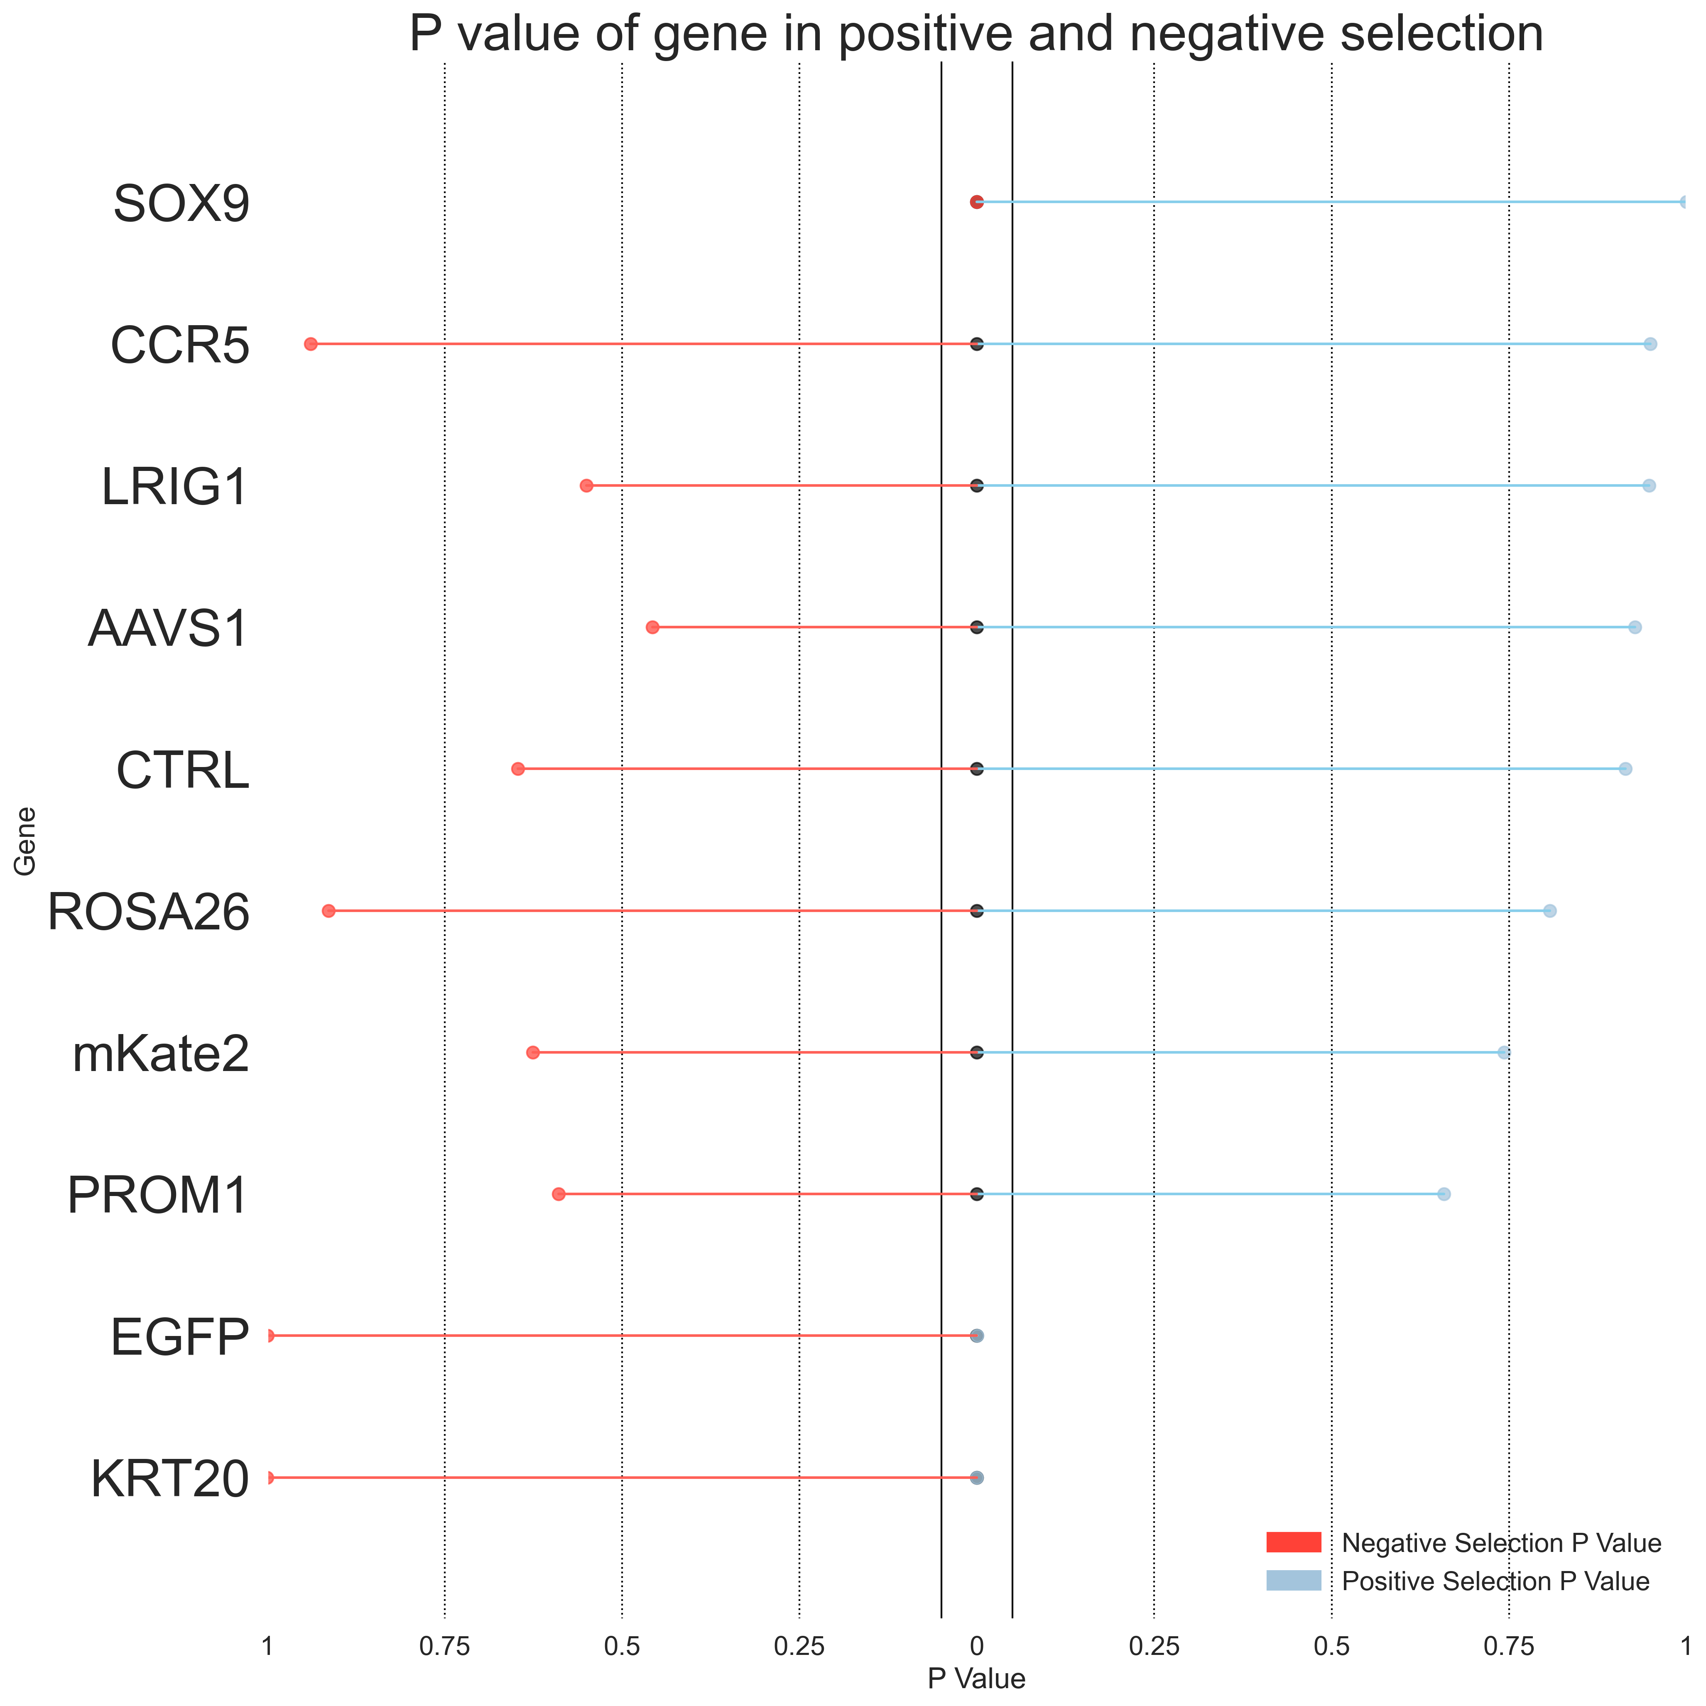
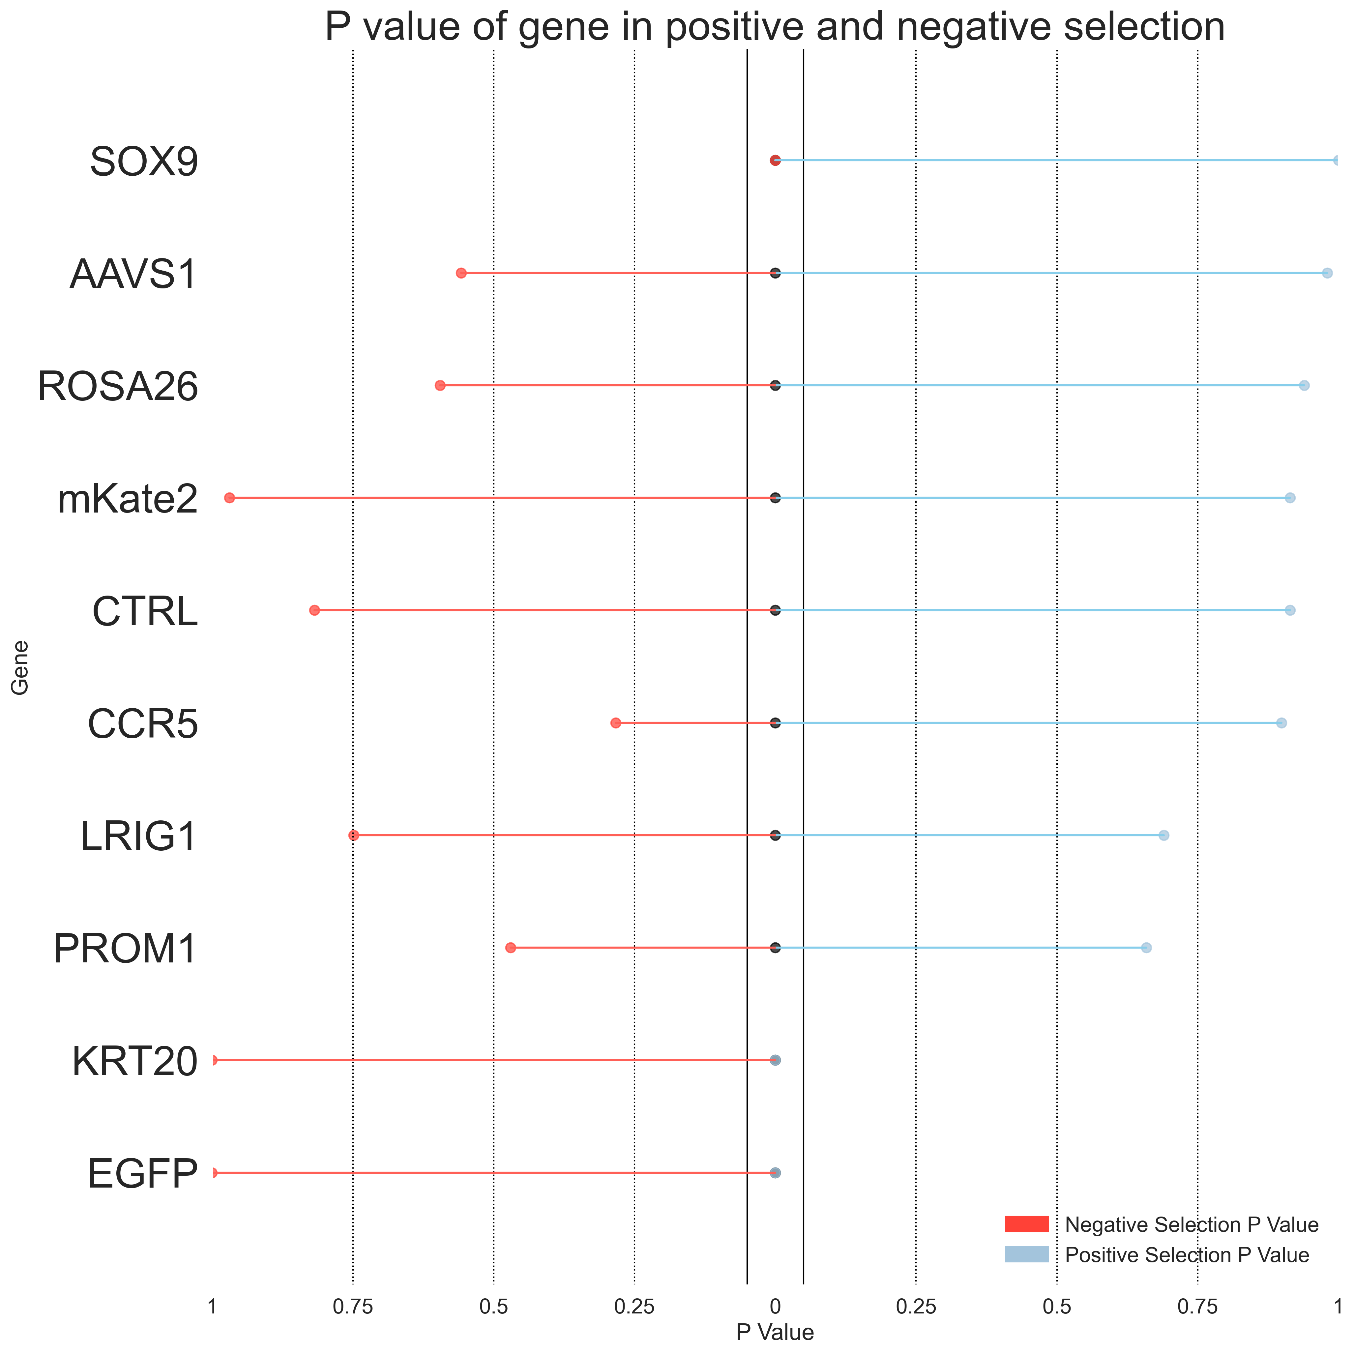
Primer 4
Top 2.5% vs Bottom 5%
Top 2.5% vs Bottom 2.5%
Day 3
Day 7
Day 3
Day 7
* Indicates P value < 0.05
*EGFP
*EGFP
*EGFP
*EGFP
*KRT20
*KRT20
*KRT20
*KRT20
*SOX9
*SOX9
*SOX9
*SOX9

Slide 14
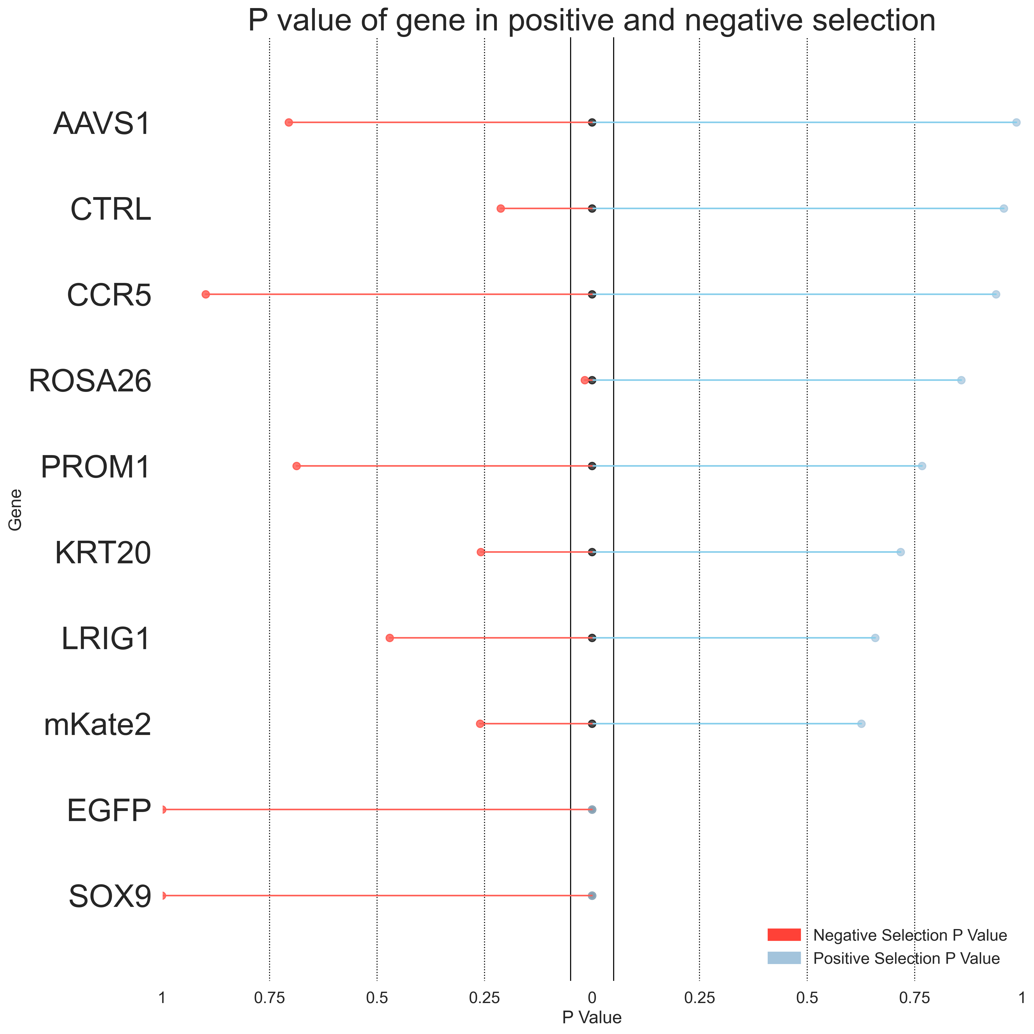
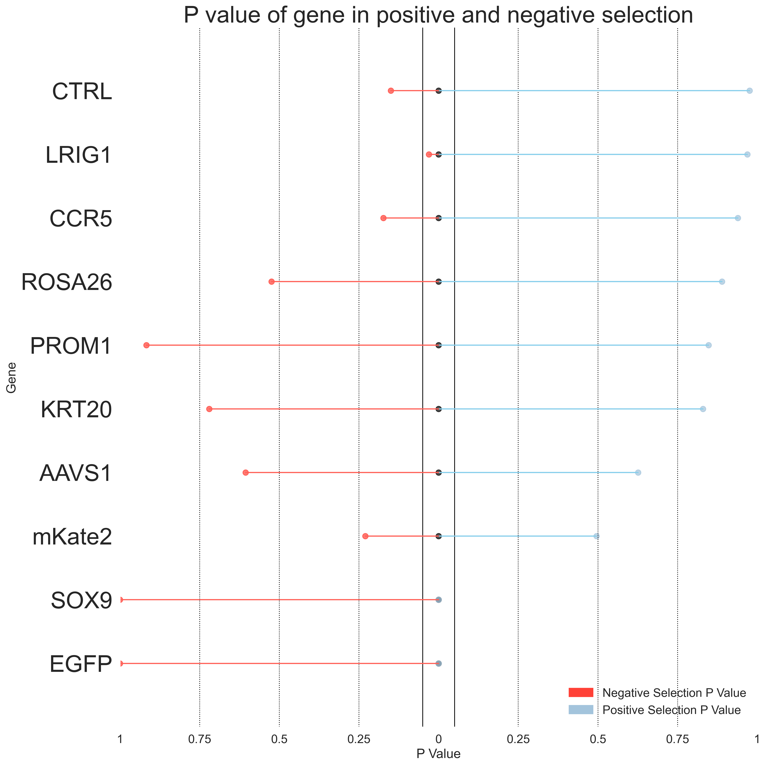
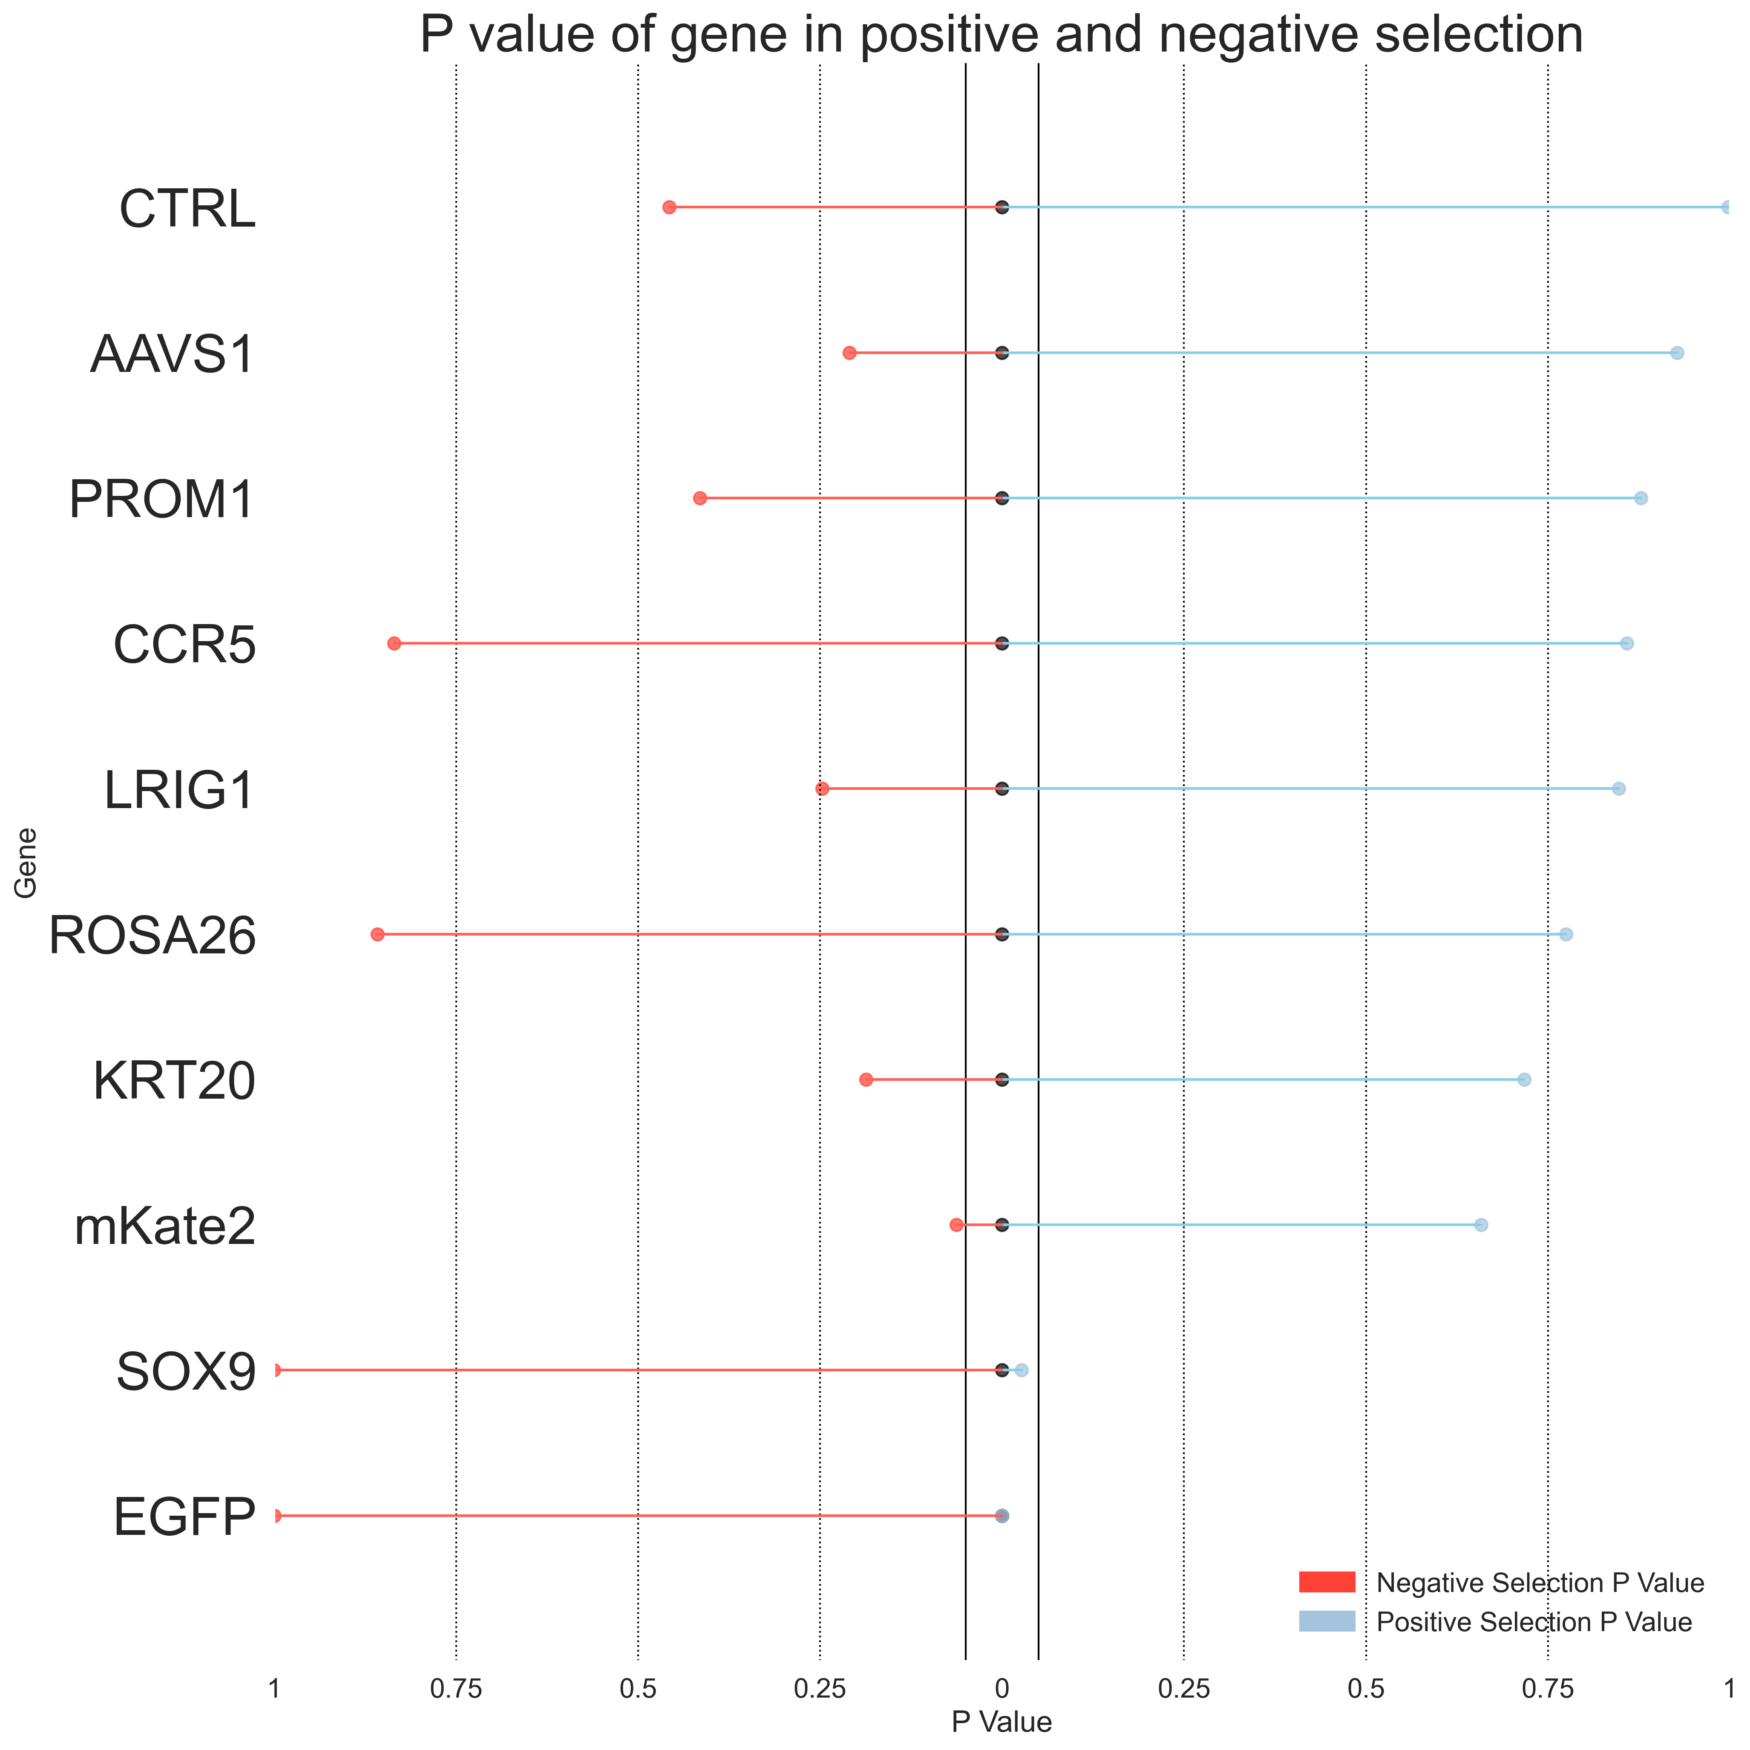
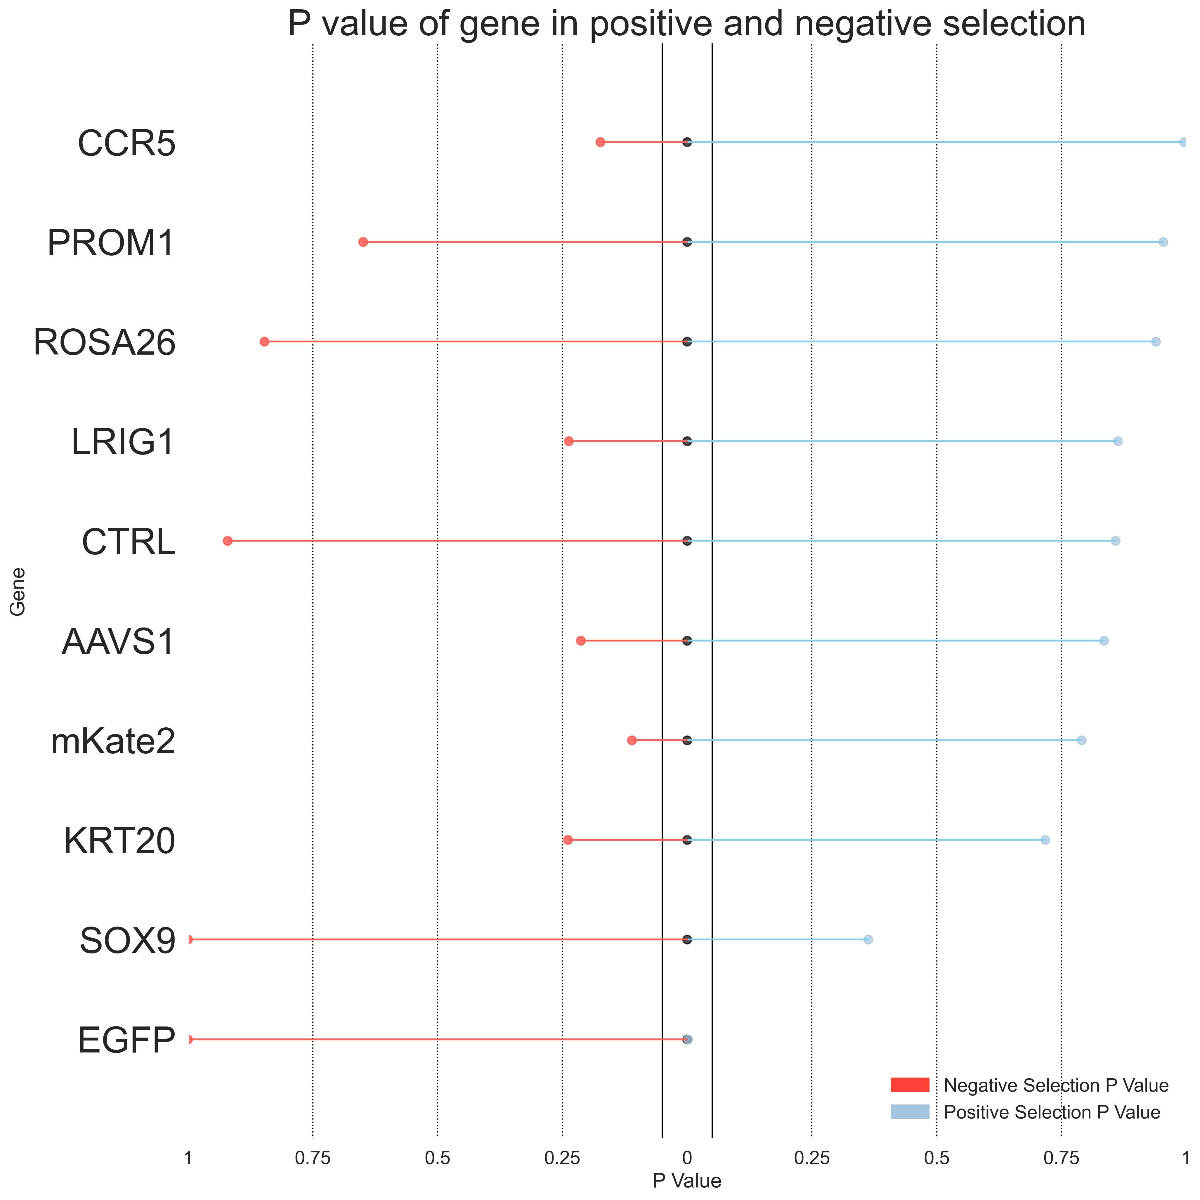
Primer 5
Top 2.5% vs Bottom 5%
Top 2.5% vs Bottom 2.5%
Day 3
Day 7
Day 3
Day 7
* Indicates P value < 0.05
*EGFP
*EGFP
*SOX9
*EGFP
*SOX9
*SOX9
*EGFP
*ROSA26
*LRIG1

Slide 15
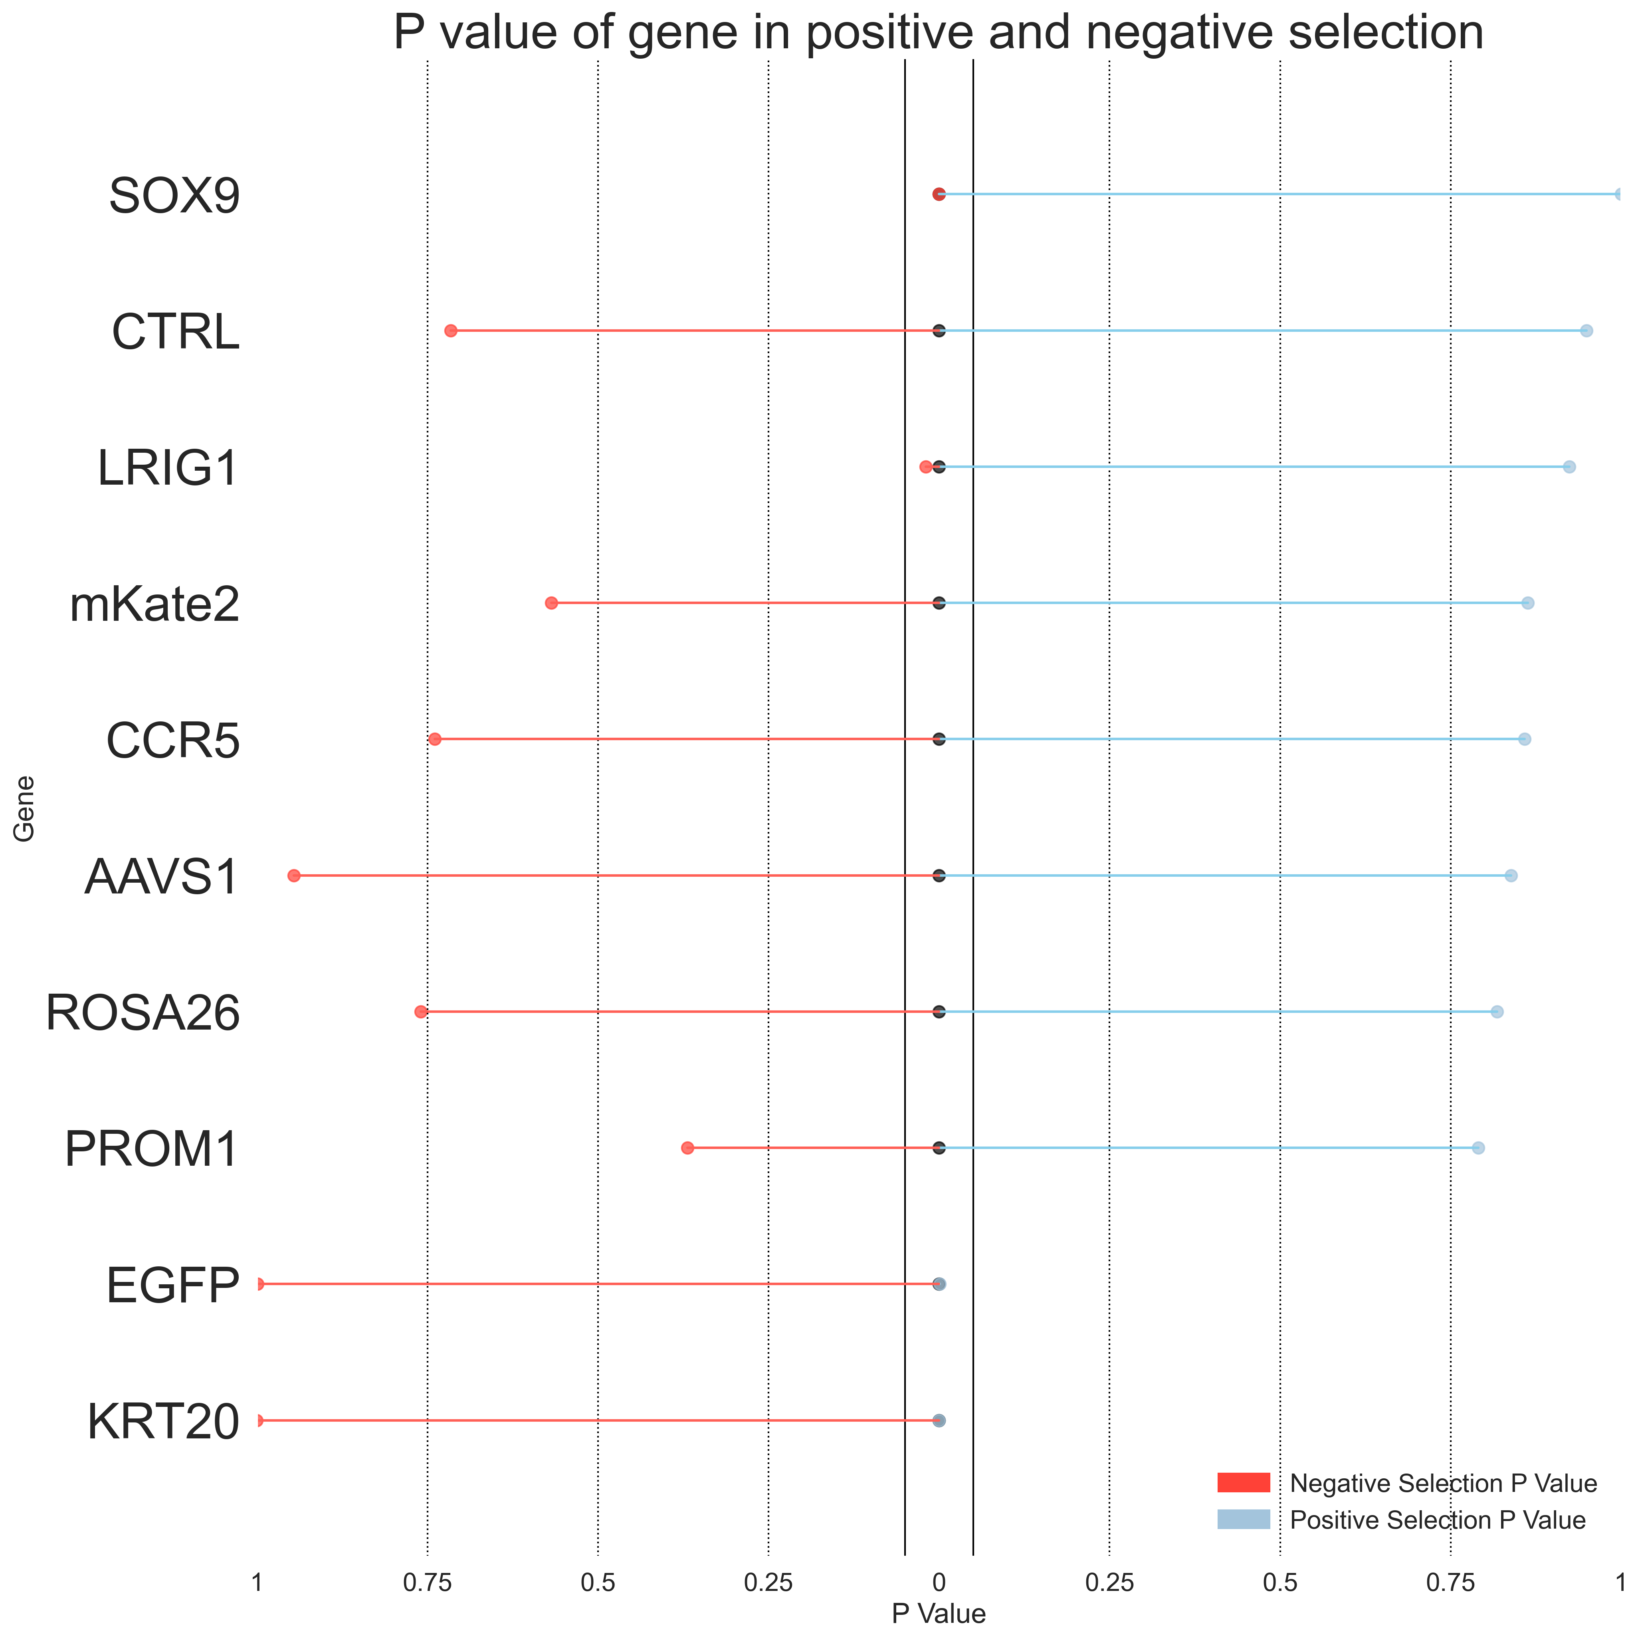
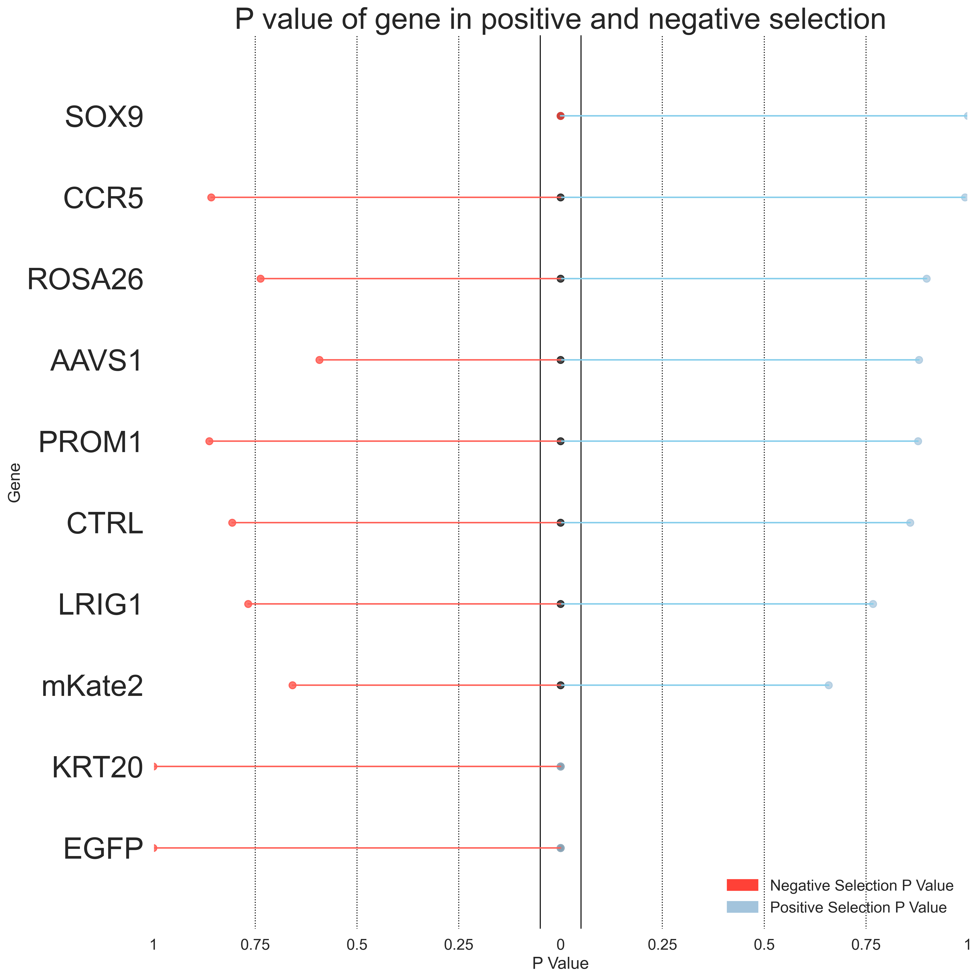
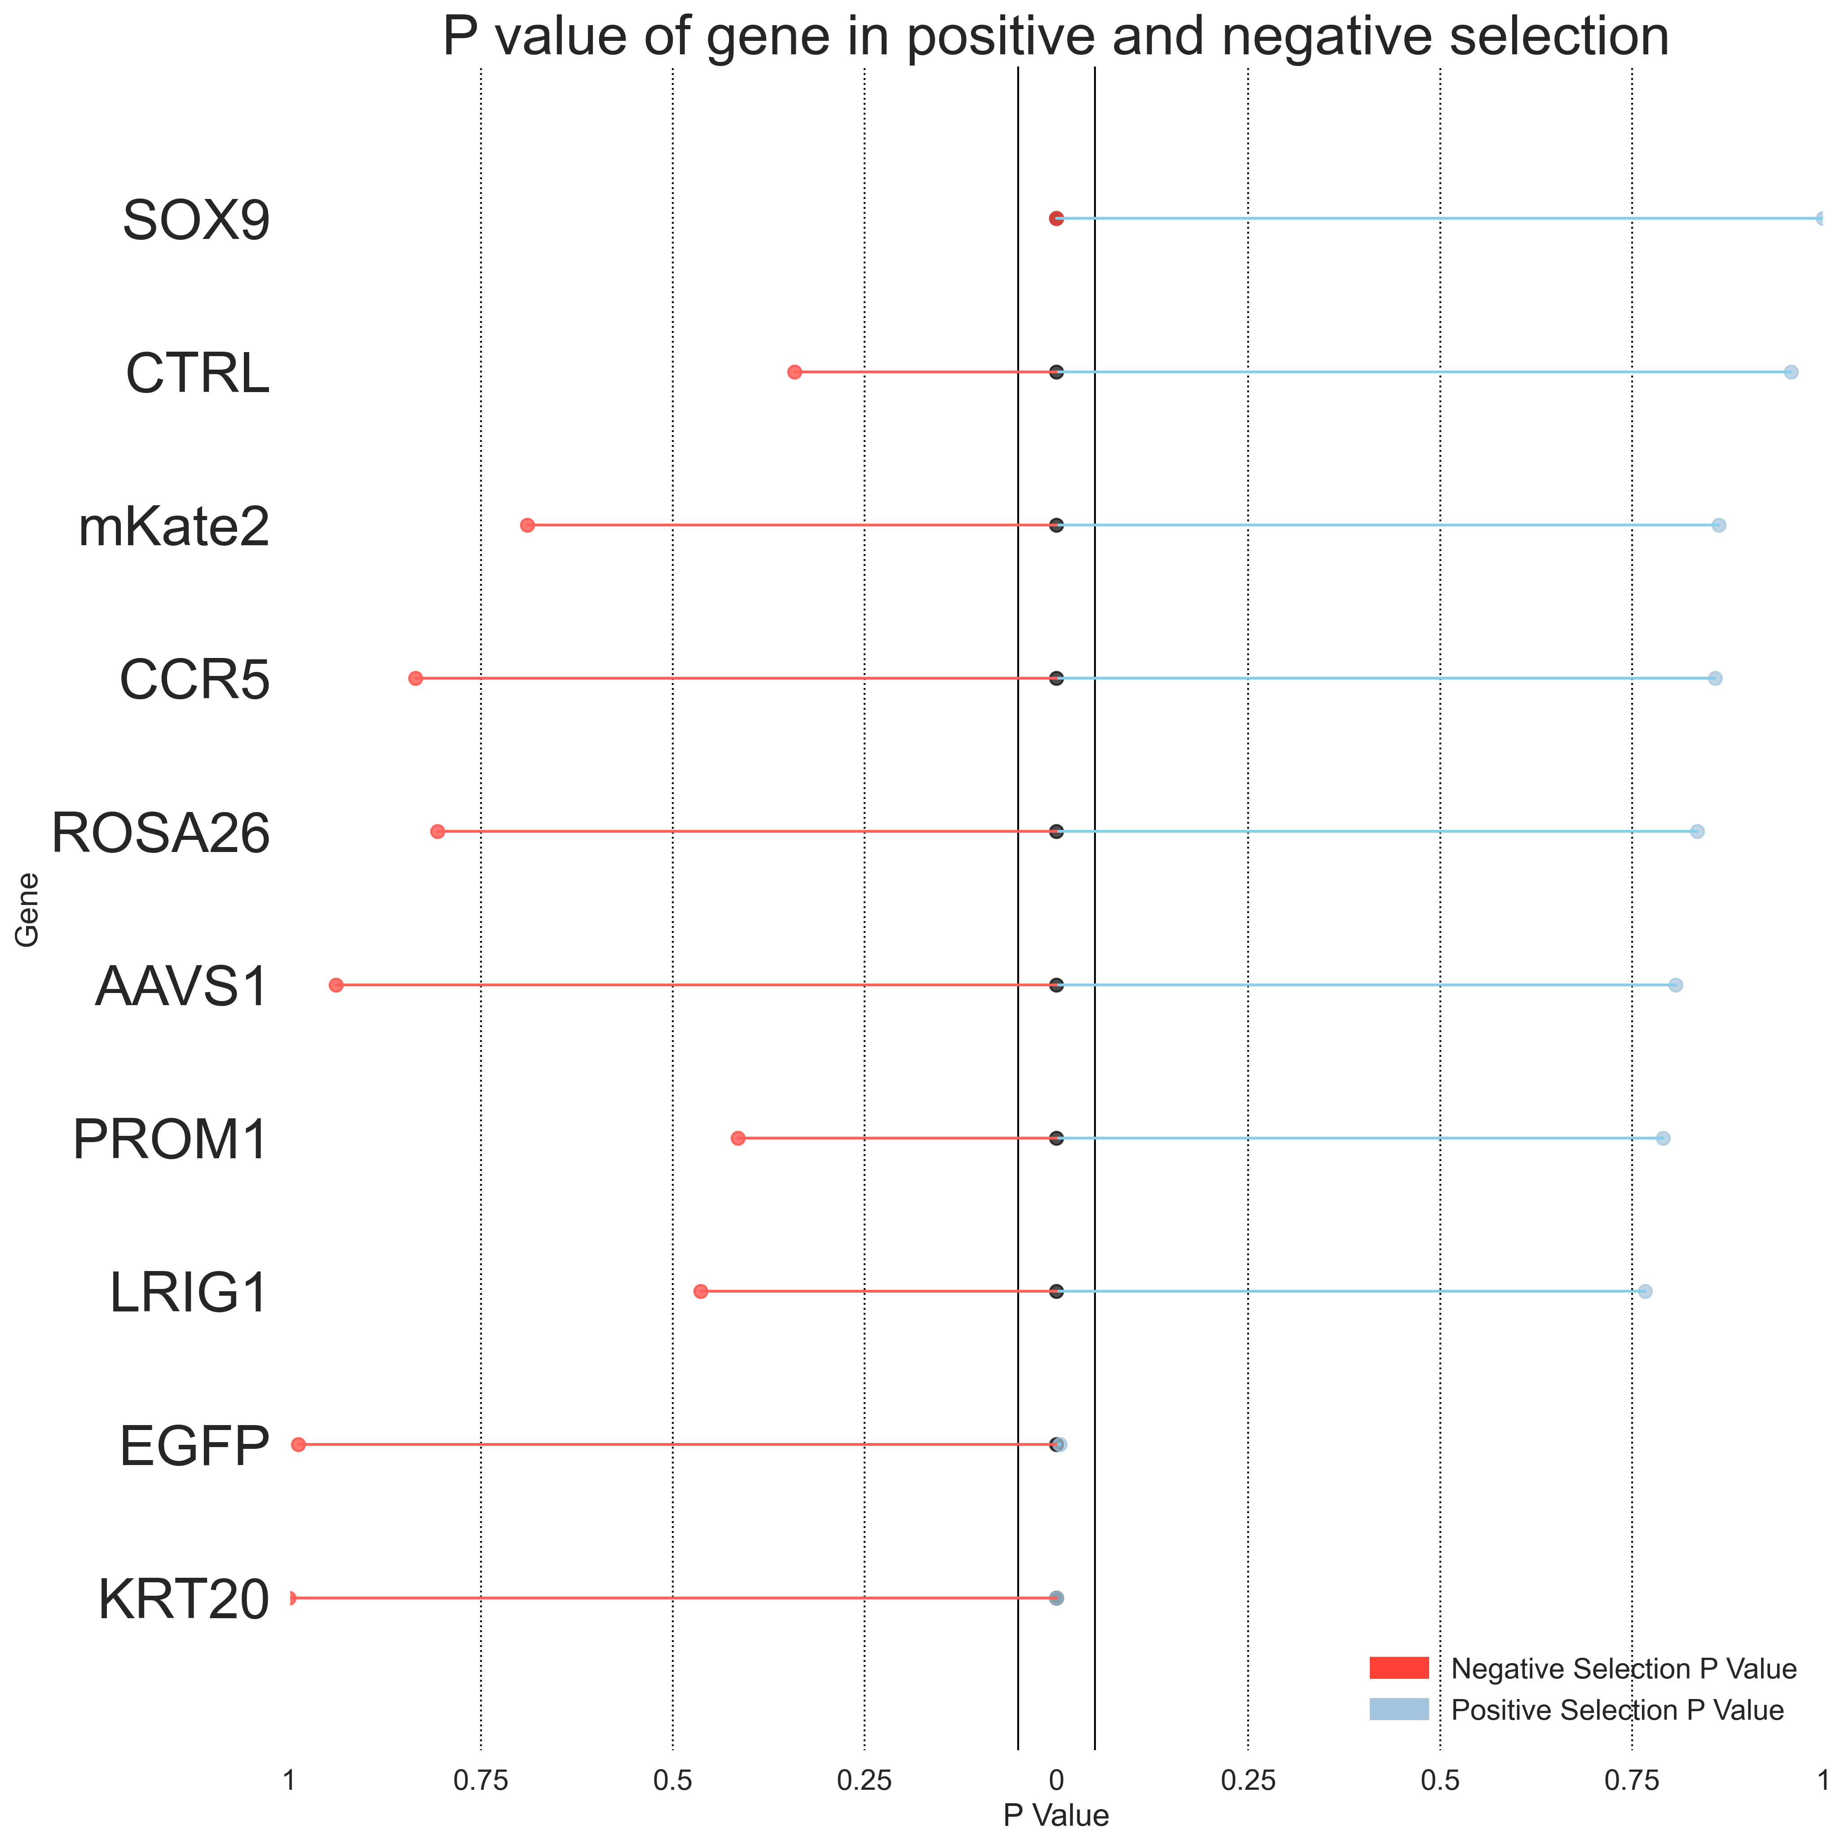
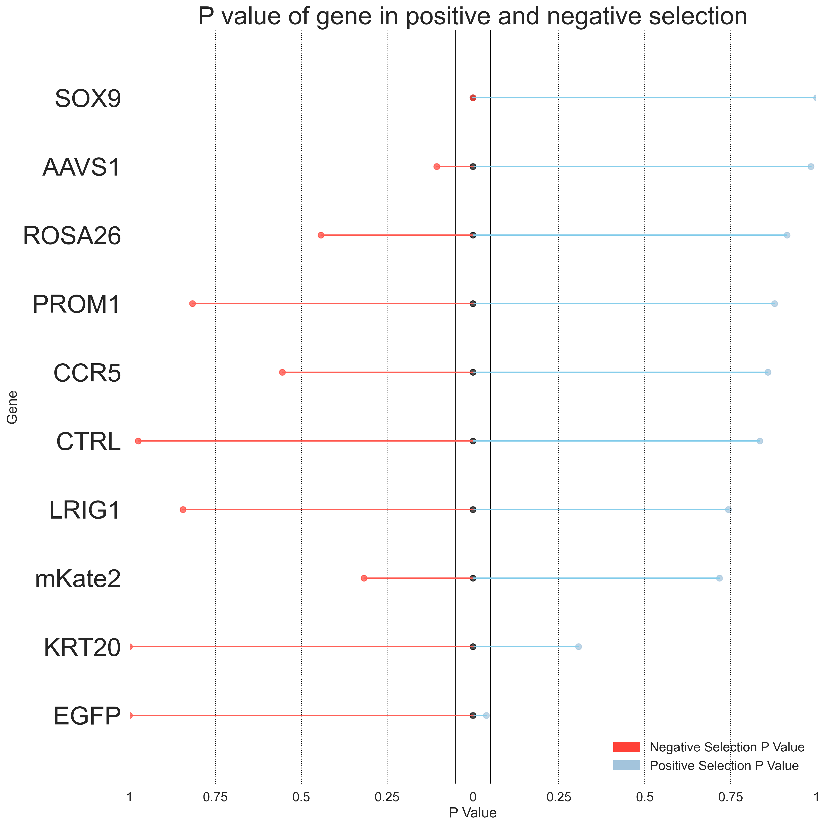
Primer 6
Top 2.5% vs Bottom 5%
Top 2.5% vs Bottom 2.5%
Day 3
Day 7
Day 3
Day 7
* Indicates P value < 0.05
*SOX9
*EGFP
*EGFP
*EGFP
*EGFP
*LRIG1
*KRT20
*KRT20
*KRT20
*SOX9
*SOX9
*SOX9

Slide 16
MaGeCK sgRNA RRA score and Two-sided P value

Slide 17
MAGeCK RRA allows comparison of two experimental conditions. It can identify sgRNAs and corresponding genes that are significantly selected between the two conditions. MAGeCK RRA ranks sgRNAs based on their p-values calculated from the negative-binomial model and uses a modified RRA algorithm named α-RRA to identify positively or negatively selected genes. MAGeCK RRA uses the RRA enrichment score to indicate the essentiality of a gene.
Wang et al., Nature Protocols (2019)
10.1038/s41596-018-0113-7

Slide 18
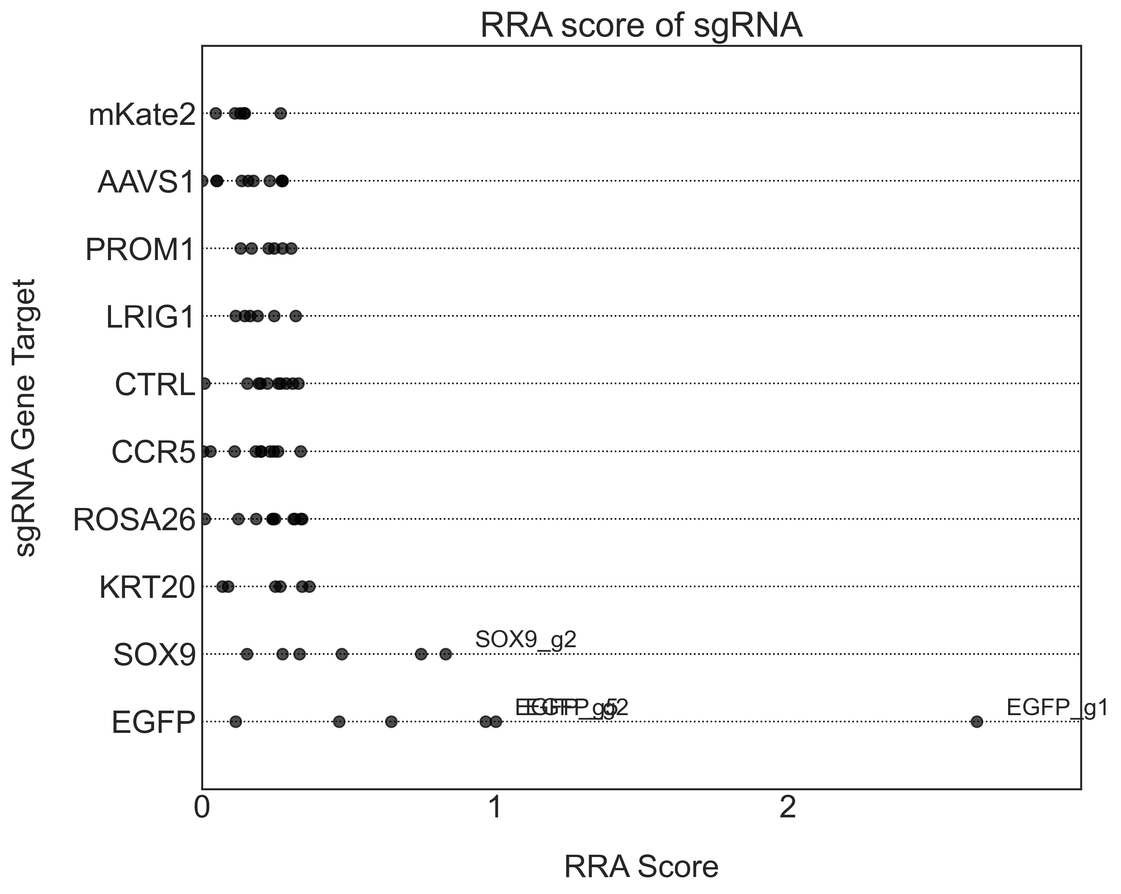
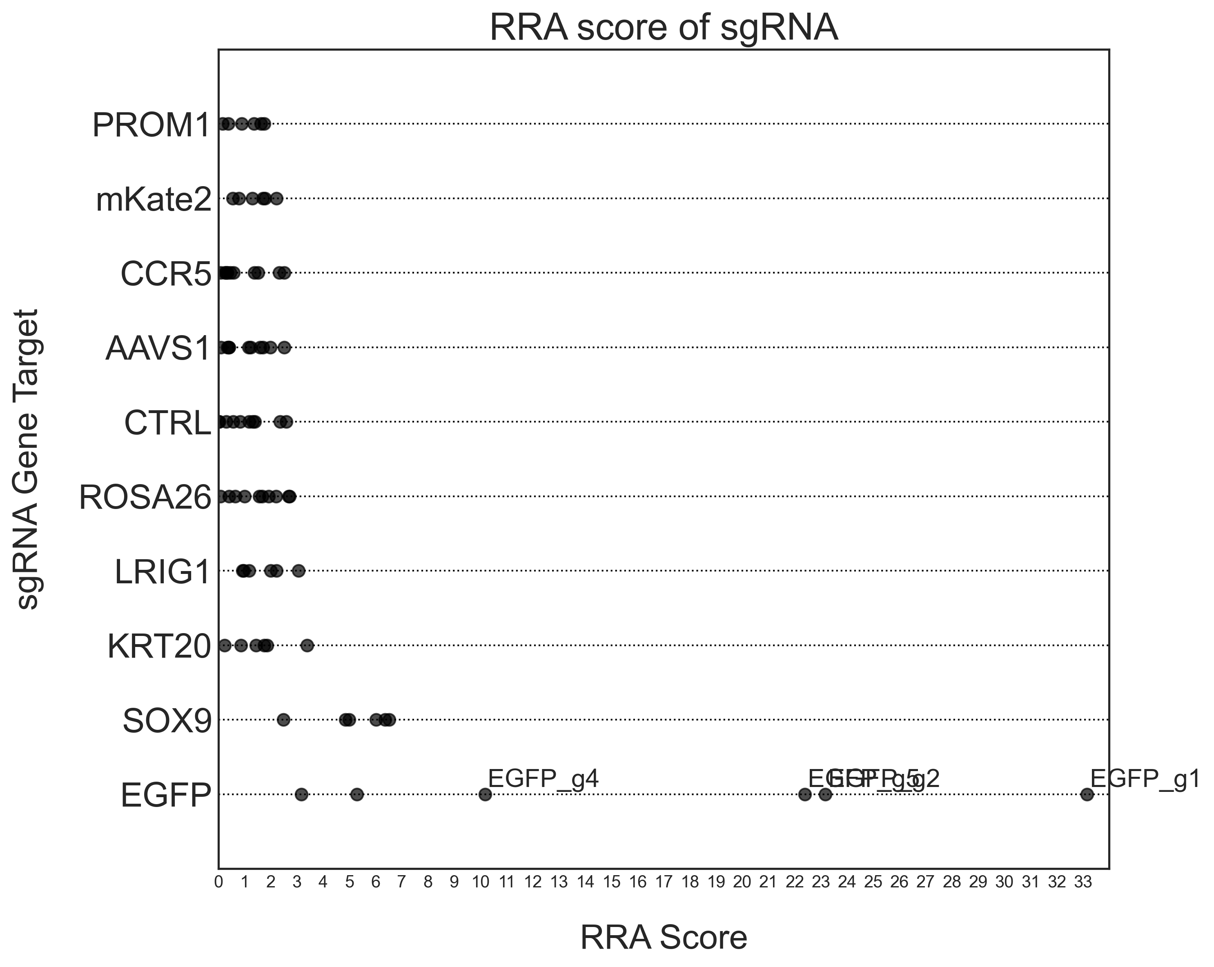


Primer 3: RRA Score
Top 2.5% vs Bottom 5%
Top 2.5% vs Bottom 2.5%
Day 3
Day 7
Day 3
Day 7

Slide 19




Primer 3: sgRNA Upper and Lower Tail P value
Top 2.5% vs Bottom 5%
Top 2.5% vs Bottom 2.5%
Day 3
Day 7
Day 3
Day 7

Slide 20




Primer 4: RRA Score
Top 2.5% vs Bottom 5%
Top 2.5% vs Bottom 2.5%
Day 3
Day 7
Day 3
Day 7

Slide 21




Primer 4: sgRNA Upper and Lower Tail P value
Top 2.5% vs Bottom 5%
Top 2.5% vs Bottom 2.5%
Day 3
Day 7
Day 3
Day 7

Slide 22




Primer 5: RRA Score
Top 2.5% vs Bottom 5%
Top 2.5% vs Bottom 2.5%
Day 3
Day 7
Day 3
Day 7

Slide 23




Primer 5: sgRNA Upper and Lower Tail P value
Top 2.5% vs Bottom 5%
Top 2.5% vs Bottom 2.5%
Day 3
Day 7
Day 3
Day 7

Slide 24




Primer 6: RRA Score
Top 2.5% vs Bottom 5%
Top 2.5% vs Bottom 2.5%
Day 3
Day 7
Day 3
Day 7

Slide 25




Primer 6: sgRNA Upper and Lower Tail P value
Top 2.5% vs Bottom 5%
Top 2.5% vs Bottom 2.5%
Day 3
Day 7
Day 3
Day 7

Slide 26
Next Steps: MaGeCK Maximum Likelihood Estimation (MLE)
Compared with the original algorithm in "test" subcommand, MAGeCK-mle uses a measurement called beta score to call gene essentialities: a positive beta score means a gene is positively selected, and a negative beta score means a gene is negatively selected. It is similar to the term log fold change in differential expression, and compared with the original RRA algorithm, this measurement has the following advantages:
It has only one score for one gene, instead of two scores in RRA: one for positive selection, one for negative selection;
It allows a direct comparison across multiple conditions, or even experiments;
It is able to incorporate sgRNA efficiency information.
Source: https://sourceforge.net/p/mageck/wiki/Home/#the-fourth-tutorial-using-mageck-mle-module

